Slide 1
OMS 3

Slide 2
Overview

Slide 3
Object Modeling System
Reduce redundancy in model development
Improve model code quality
Simplify model technology transfer
Allow simulation traceability, support auditing
Improve model maintainability
Flexible use and rigorous testing of models
Allow flexible change in science
Open source
Software Framework for Environmental Modeling
“Science building blocks”

Slide 4
System Components
OMS Principal Architecture
Science Components
Component Based Model
Data IO
Temporal
Erosion
Spatial
Time
ETP
Plant Growth
Plant growth
Irrigation
Space
Inter- ception
Groundwater
Erosion
Water Quality
Control
Snow
Surface RO
Stream RO
Statistics
Surface water use
ET
Soil- water
SS RO
Ground water use
....
Ground-
water
GW Flow
Optimization
Uncertainty
Sensitivity
Calibration
Visualization
Reporting

Slide 5
OMS3 Features
Lightweight, non-invasive, component-based modeling framework
Dataflow driven, Multithreaded execution
Multi-language support
Conversions / Transformation SPI
(Ontologies)
DSLs for Simulations, Calibration, Uncertainty, and Sensitivity analysis
Auditing, Traceability, Doc generation
EMF interoperability

Slide 6
History of the OMS development
2001/02 2003/04 2005/06 2007/09 2010/12/13
Initial Prototype
Swing based
Netbeans Platform
Refactoring
Central Version Control
Standardize Component API
PRMS - Prototype
Modeling Projects
USDA CoLab Use
Project Plan/Process
PRMS WSF
CEAP
Calibration Tools
Sensitivity Analysis
Uncertainty Analysis
Data Provisioning
Agency Governance
J2000(S), PRMS WSF, WWEM, Range,
OMS3
COSU
CSIP
Cloud Computing
Parallelization
CEAP-AgEs, AgesUI, PRMS WSF, WWEM, Range, McCabe MWB
WASP-Hydrus 1D
Hymod, (GeoTop)
IAEA Rusle2

Slide 7
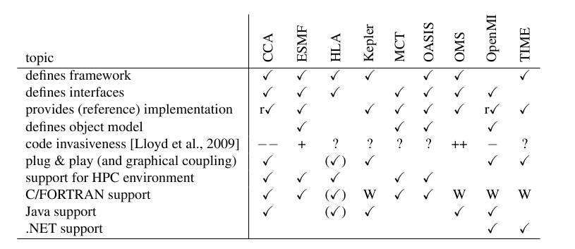
OMS3 and other IMFs
Jaegers B. et al., 2010 Proc IEMSS, Ottawa, Canada

Slide 8
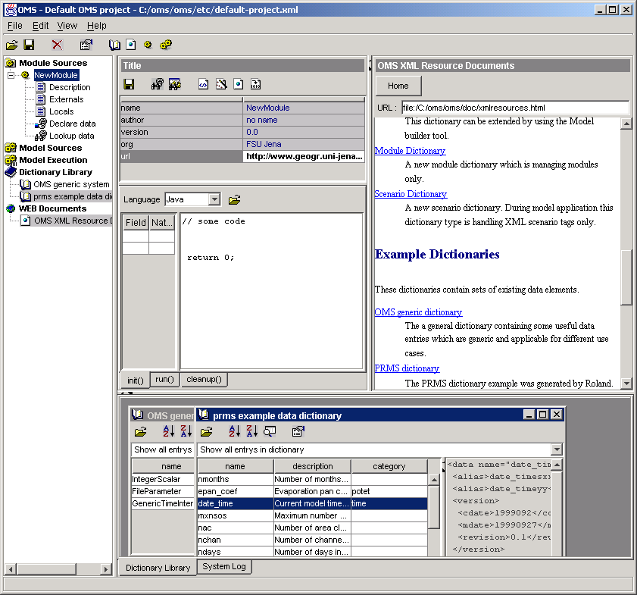
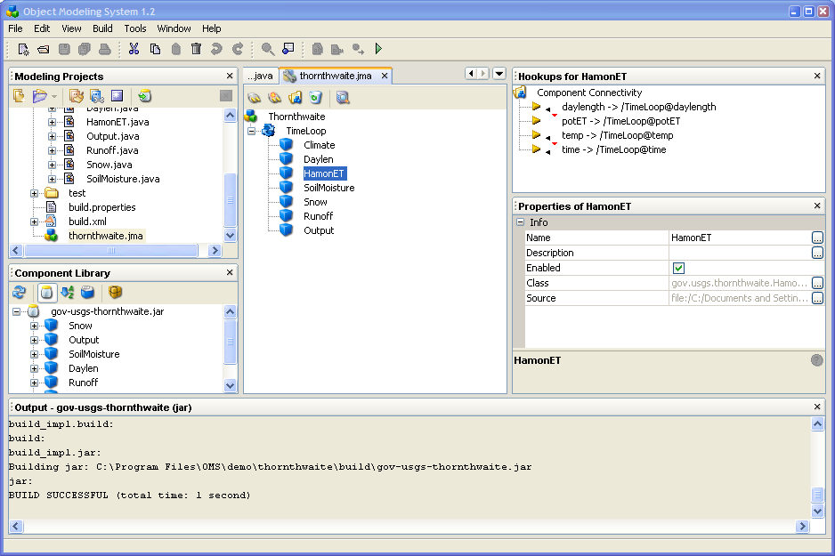
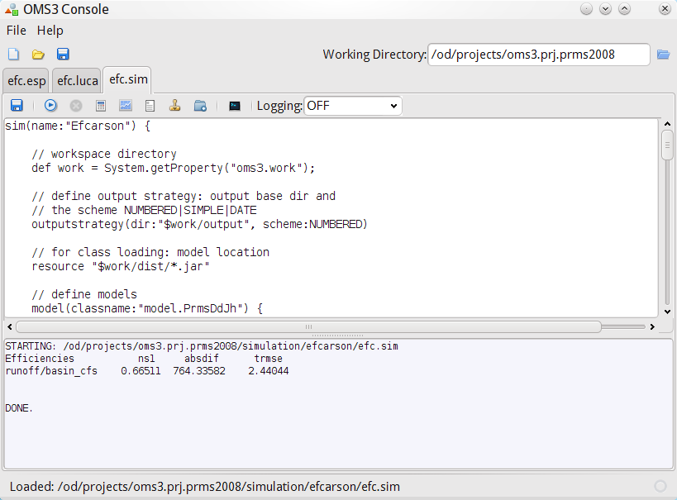
OMS Console Versions
1.0
2.2
3.0

Slide 9
Example Measures McCabe WBM
Language/ Framework | Total LOC | Average CC/method | Total CC
FORTRAN only | 244 | 3.33 | 40
OMS 3.0 Java | 295 | 2.38 | 31
Java only | 319 | 2.85 | 37
C++ only | 405 | 2.41 | 41
OMS 2.2 Java | 450 | 1.18 | 103
ESMF 3.1.1 C | 583 | 1.97 | 65
ESMF 3.1.1 FORTRAN | 683 | 1.44 | 56
OpenMI 1.4 Java | 880 | 1.61 | 116
CCA 0.6.6 Java | 1635 | 2.25 | 276
[Lloyd, 2011]

Slide 10
Component Class Design
Modeling Component
= POJO + Annotations
Plain Old Java Object
Meta data provide execution control and connectivity, execution support, and documentation/repository support

Slide 11
POJO + Annotations
Simple example component with annotated I/O fields .
public class CircleArea { @In public double radius; @Out public double area; @Execute public void runme() { area = Math.PI * radius * radius; }
}
Tag the fields being used for input and output with @In and @Out
Fields can have any data type (primitive, custom, or parameterized types) and should be public.
No arguments for @In and @Out
Required Meta data

Slide 12
POJO + Annotations
Simple example component with annotated I/O fields .
public class CircleArea { @In public double radius; @Out public double area; @Execute public void runme() { area = Math.PI * radius * radius; }
}
Tag the fields being used for input and output with @In and @Out
Fields can have any data type (primitive, custom, or parameterized types) and should be public.
No arguments for @In and @Out
Required Meta data
Applies similar to languages such as FORTRAN, C, C++

Slide 13
Building Models
class GroundwaterN {
@Out
public HRU hru;
...
}
class PlantGrowthStress {
@In
public HRU hru;
...
}
intc : Interception
pgs: PlantGrowthStress
hru
hru
…
out2in(intc, “hru”, pgs);
…
… out2in, field2in, out2field, feedback, ..

Slide 14
Annotations
Component
Field
Method
@Description
@Author
@Bibliography
@Status
@VersionInfo
@SourceInfo
@Keywords
@Label
@Description
@Unit
@In
@Out
@Range
@Role
@Bound
@Label
@Execute
@Initialize
@Finalize

Slide 15
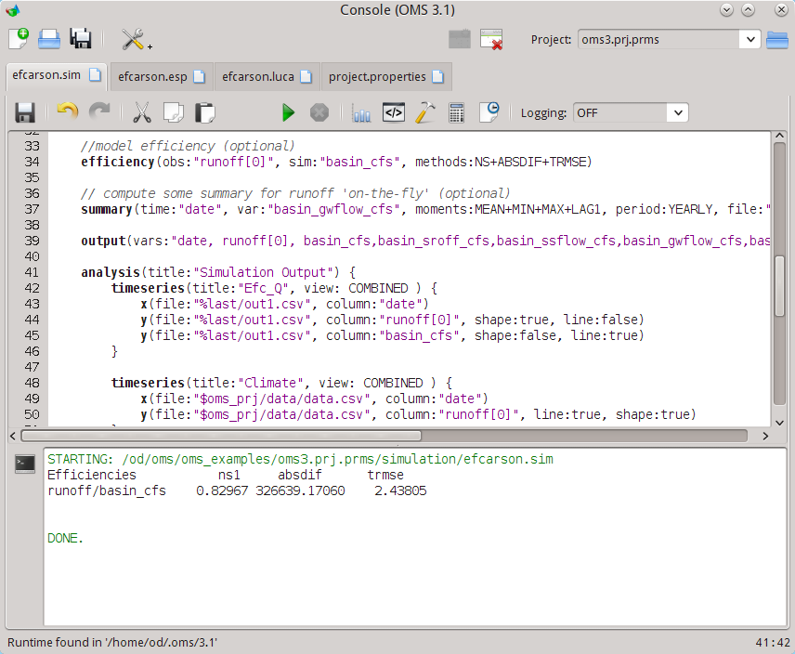
Simulation Tabs
Project Directory
Toolbar
Toolbar
Simulation Editor
Console Output
Status Line

Slide 16
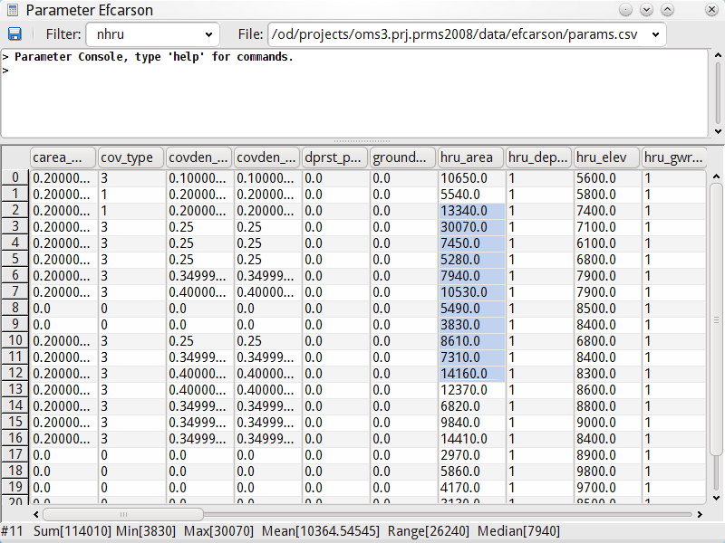
Table View (Filter for ‘nhru’ dimensioned parameter)
Statistics on Selection

Slide 17
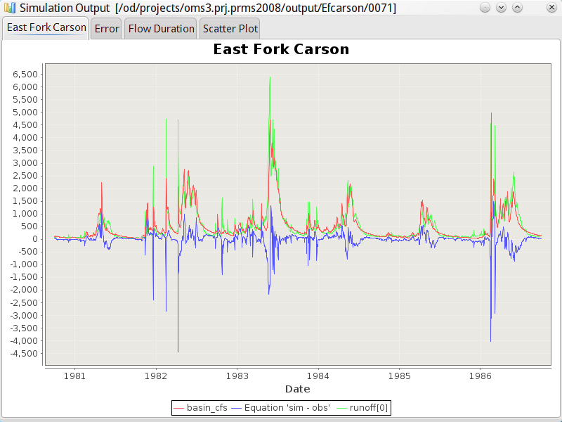
Output folder
Analysis tabs

Slide 18
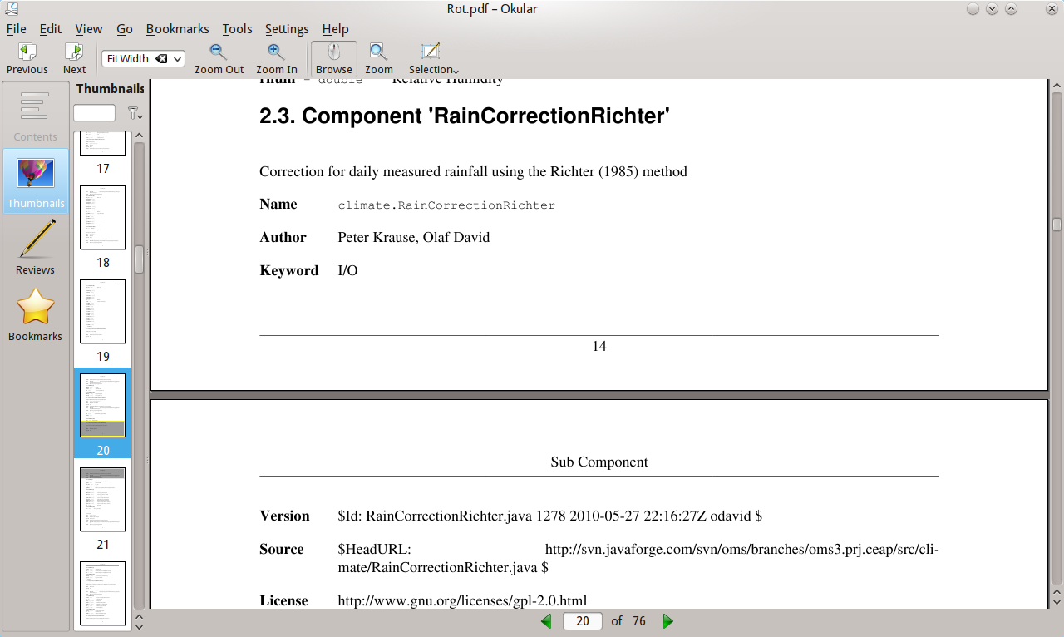
Auto Documentation
Docbook5
Model meta data
Components meta data
Parameter sets
Simulations
Docbook5 →
PDF
HTML
DOC(X)
…

Slide 19
OMS3
Simulations
Groovy (DSL)
OMS3 Runtime
Java
Components / Model
Java / FORTRAN / C / C++

Slide 20
DSLs for simulation
Lightweight model ‘orchestration’ layer
Based on language level Builder Pattern
Descriptive and programmatic
Scalable for various modeling applications
Flexible, domain expert can understand it

Slide 21
ESP batch processing
// ..
scripts = [
"yampa/yampaStmBtXyz.esp",
"east/eastXyz.esp",
"animas/animasXyz.esp"
]
// Initialization end forecast end
initEnd = "2005-04-30"
fctEnd = "2005-05-30"
// pass system properties for others to read.
System.setProperty("out", today.toString());
System.setProperty("initEnd", System.getProperty("initEnd",initEnd))
System.setProperty("fctEnd", System.getProperty("fctEnd", fctEnd))
work = System.getProperty("work") + "/simulation"
println "Batch ESP run '$today' forecasting " + System.getProperty("initEnd") + "..."+ System.getProperty("fctEnd");
scripts.each {
println "Running '$it' ..."
res = Eval.me(new File("$work/prefix.sim").text + new File("$work/$it").text);
res.run()
}

Slide 22
OMS3 Simulations
Simulations = Model applications with data
Calibration
Shuffled Complex Evolution(SCA) Dynamically Dimensioned Search (DDS), LUCA (MO SCE),
Sensitivity Analysis
Morris Screening, Extended FAST, ..
Uncertainty Analysis
GLUE, Bayesian Monte Carlo,…
Forecasting
Ensemble Streamflow Prediction

Slide 23
Applications

Slide 24
OMS3 Applications
OMS3/AgES → 5 year CRIS ARS
OMS3/JGrass →(Univ Trento/HydroloGIS)
OMS3/McCabe WBM → Nile Project (IAEA)
OMS3/Rusle2 → CDSI (CSIP NRCS)
OMS3/PRMS → WSF NRCS NWCC
OMS3 NSF/USDA → CSU
OMS3 Geotop → Univ Trento / Univ Calabria
OMS3 NewAge → Univ Trento
OMSLab

Slide 25
AGES-W

Slide 26
AgES vs. SWAT …
The semi-distributed SWAT concept considers distributed information within a subbasin only statistically but not in terms of its location.
Important processes e.g. lateral water and nutrient transport, specific management in some parts of a subbasin cannot be simulated.
The fully distributed AgES concept allows the consideration of such processes.
[Krause]

Slide 27
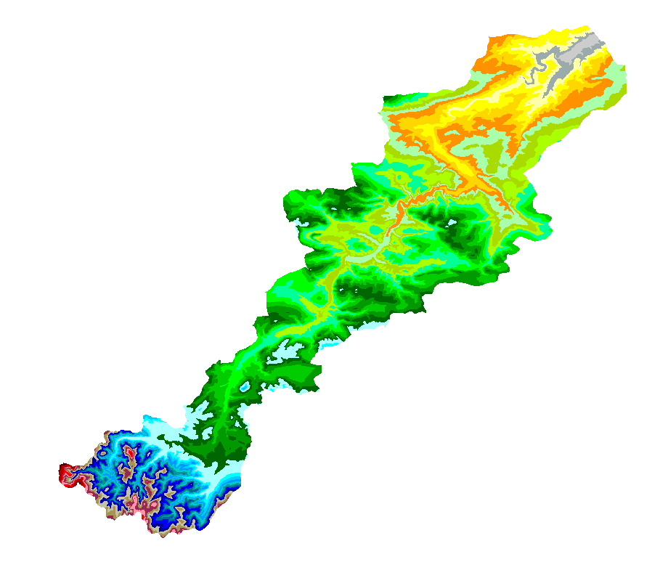
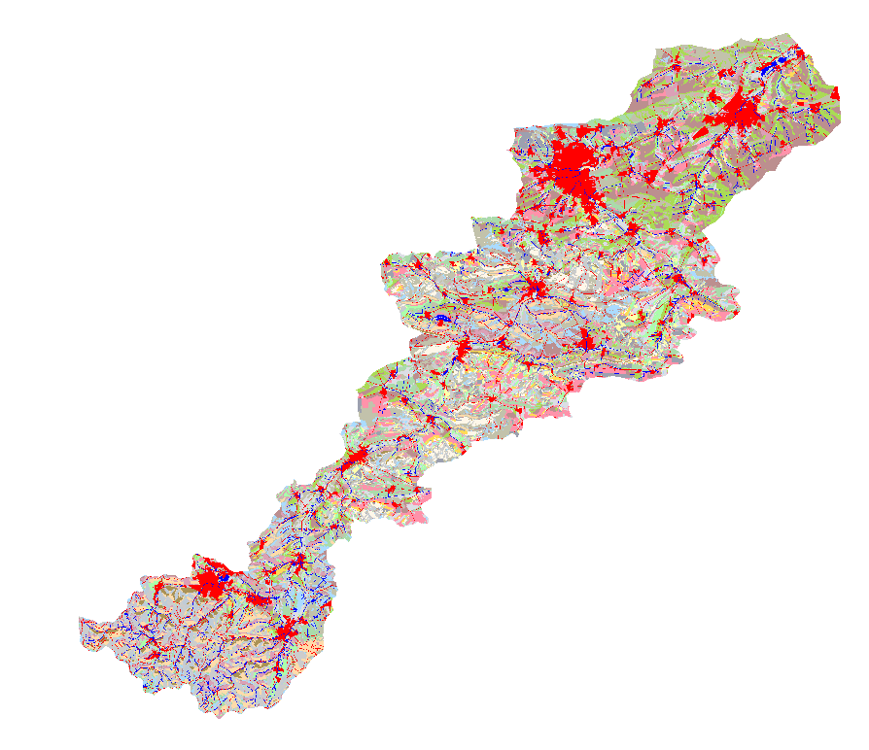
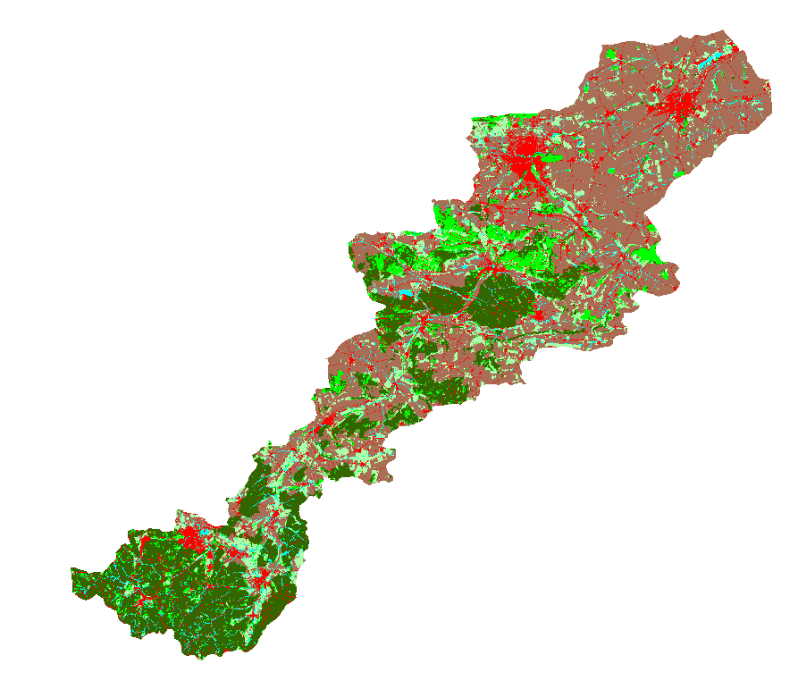
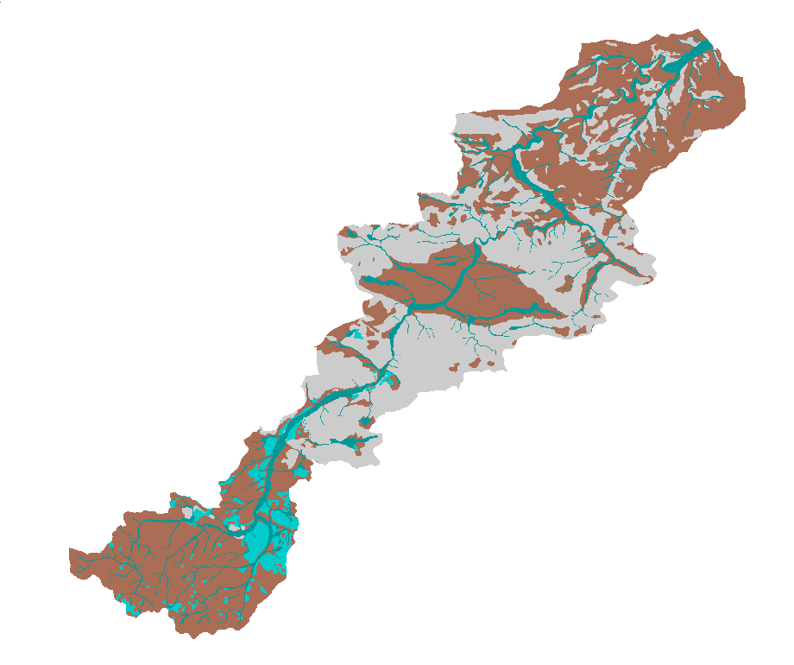
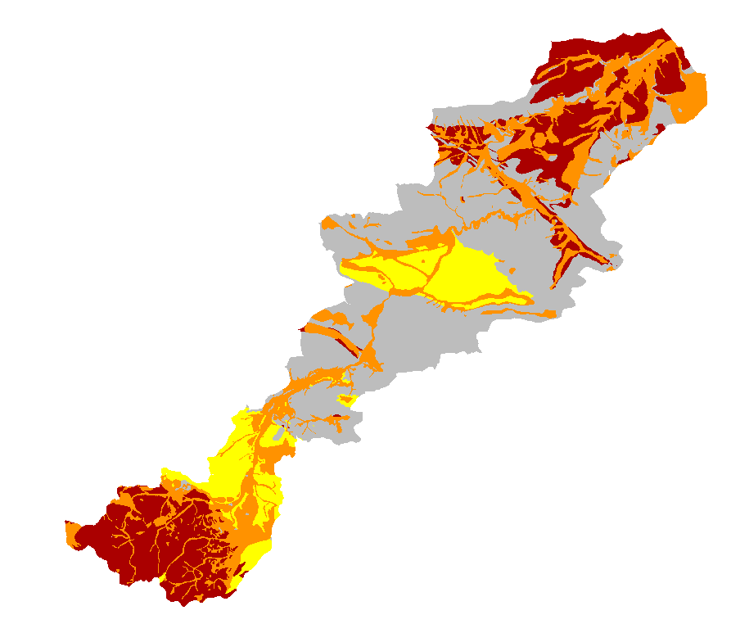
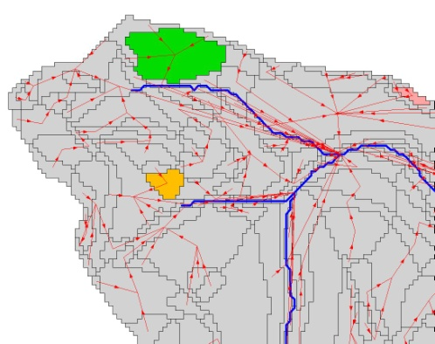
HRU delineation …
The scalable Response Unit distribution concept allows process oriented classification of catchments without loss of important information
Combined with a topological routing scheme vertical and lateral processes can be modelled fully distributed
Topography
Landuse, land-cover
GIS Overlay
Soil-types
Hydrogeology
Flügel, 1996 Bongartz, 2001
Staudenrausch 2001

Slide 28
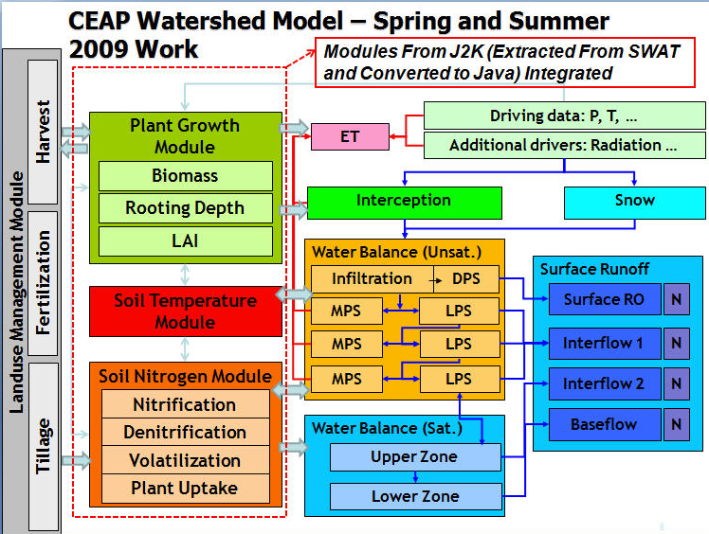
AgES Watershed Model
Expansion of CEAP Watershed Model using SWAT, RZWQM, AnnAGNPS, and WEPP modules
MUSLE Erosion

Slide 29
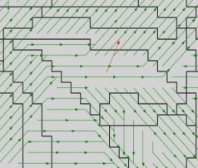
Init
Temporal/Spatial Processing
tmean
Surface - Processes
SubSurface - Processes
Routing
Tmin
J2KProcessLayeredSoilWater2008
J2KPlantGrowth
WaterStress
J2KProcessReach
Routing
Regiionalizer
CalcIDWeights
Regiionalizer
Tmax
CalcIDWeights
Regiionalizer
CalcIDWeights
Regiionalizer
CalcIDWeights
Regiionalizer
J2KSNDormancy
J2KPlantGrowth
TempStress
CalcIDWeights
Regiionalizer
J2KProcessReach
RoutingN
CalcIDWeights
Regiionalizer
CalcIDWeights
Ahum
CalcIDWeights
Relative Humidity
ETPETP
J2KPlantGrowth
NitrogenStress
Output
Solrad
AreaWeight
Wind
ManageLanduse
Szeno
J2KPlantGrowthStress
Output
LatLong
DailyNetRadiation
AreaAggregator
PotCropGrowth
J2KProcessHorizon
Routing
LanduseStateVars
Penman/Monteith
J2KSoilTemplayer
J2KNRoutinglayer
EntityReader
ExtraTerrRad
Rain/Snow Parts
J2KNSoilLayer
Management
Reader
Interception
J2KProcess
Groundwater
Snow
J2KGroundwater
N2005
Initialization
HRU x
HRU 1
HRU 2
HRU 3
HRU ?
HRU ?
Creation
HRU 4
HRU 5
HRU 6
Reach 1
Reach 3
Reach 2
Reach x
AgES J2000/SN OMS3 components

Slide 30
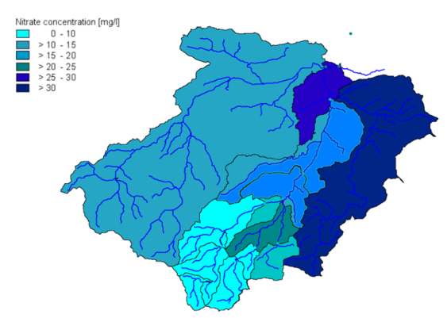
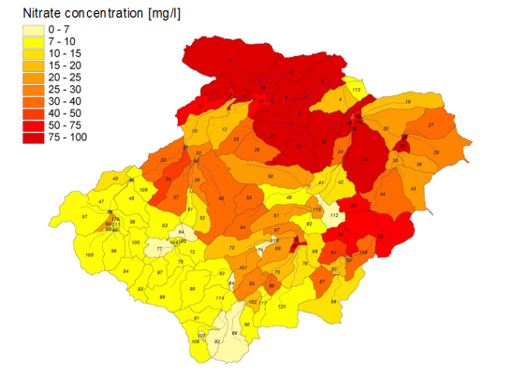
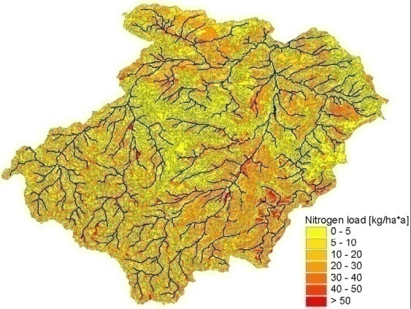
OMS3/AgES Watershed Model
Status of Science Components
Soil water balance (Java, J2000/New)
Soil/groundwater/stream N dynamics accounting (Java, SWAT)
Muskingum stream routing (Java, J2000/New)
Canopy interception and surface depression storage (FORTRAN, WEPP)
Kinematic wave overland/Smith-Parlange infiltration (FORTRAN, Kineros2)
Soil temperature component (Java, J2000)
Crop growth component (Java, SWAT)
Crop growth component – UPGM (FORTRAN, WEPS/New)
Land use/tillage management component (Java, SWAT)
Tile drainage (Java, DRAINMOD/RZWQM2)
Erosion – RUSLE (FORTRAN, AnnAGNPS/New), MUSLE (Java, SWAT), WEPP Hillslope (FORTRAN, WEPP)
Observed
SWAT
CEAP Watershed

Slide 31
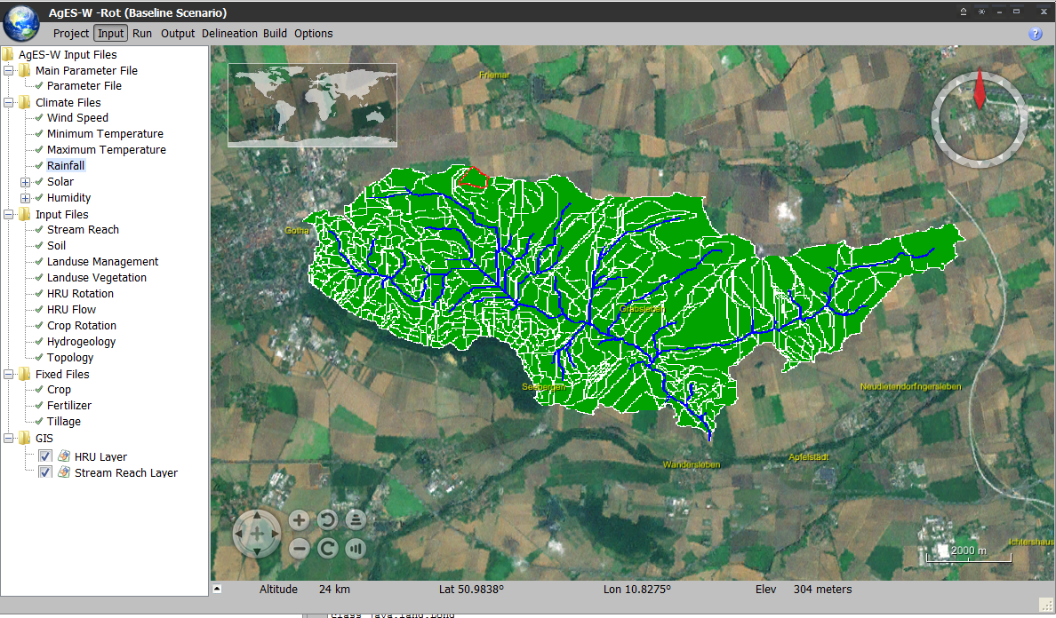
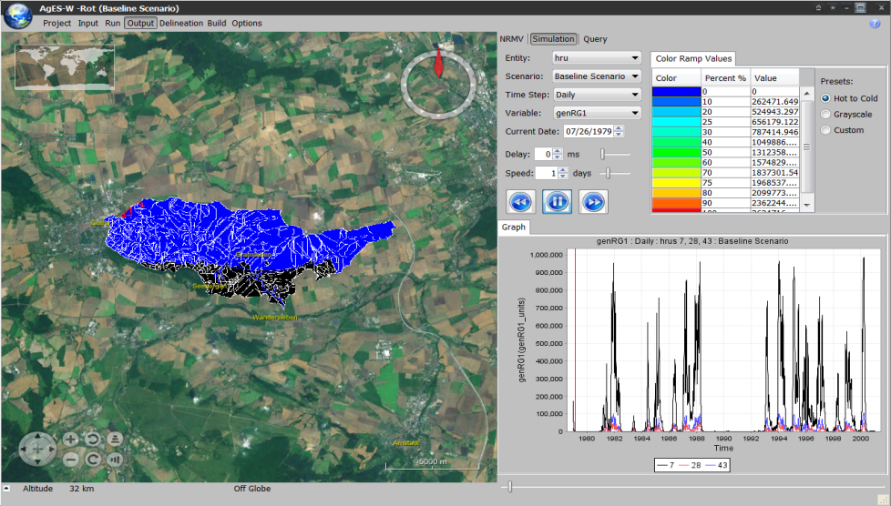
AgES UI (OMS3 RT)

Slide 32
Jgrass / OMS

Slide 33
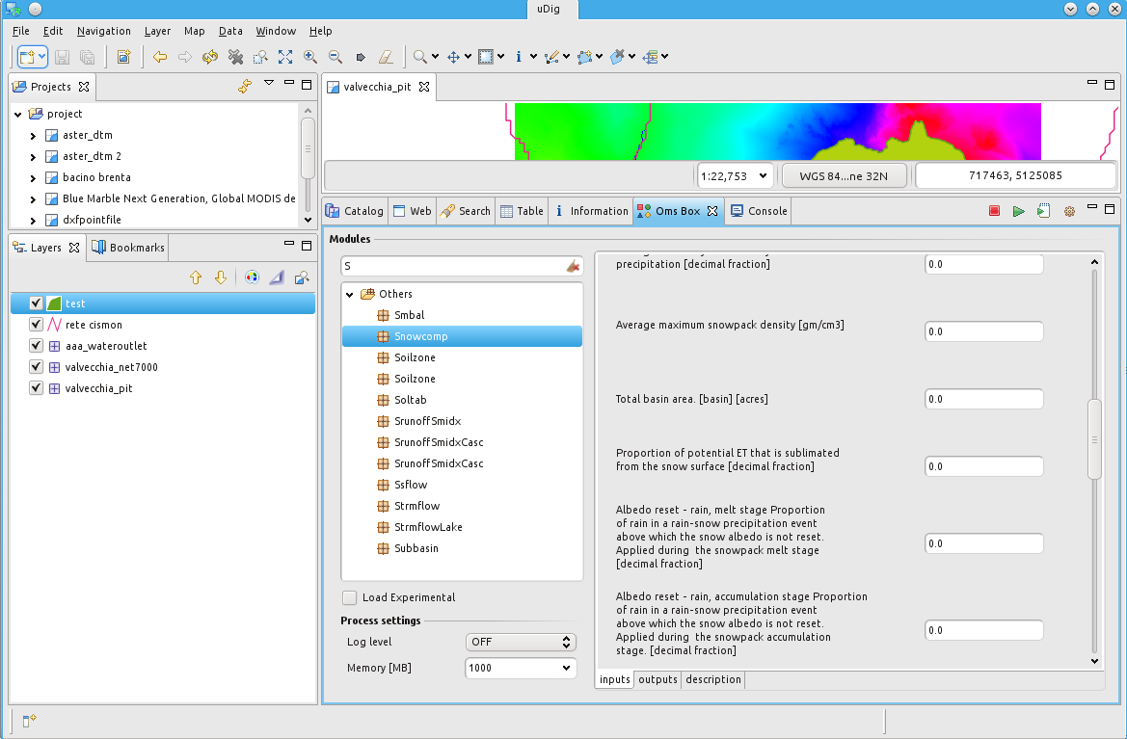
OMSBox (Modeling Support in uDig)

Slide 34
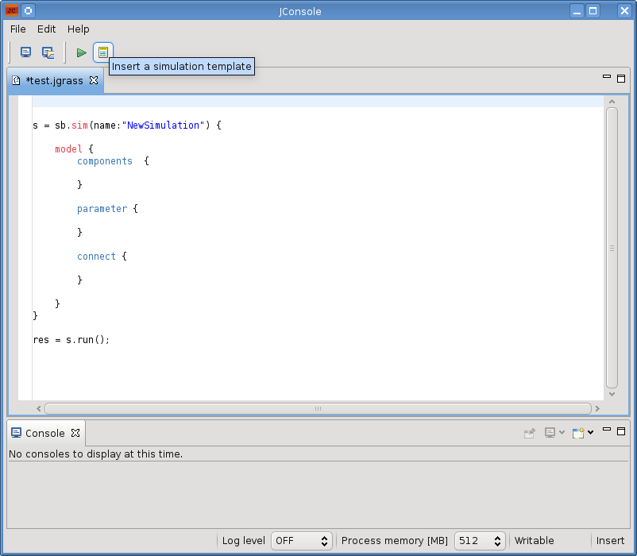
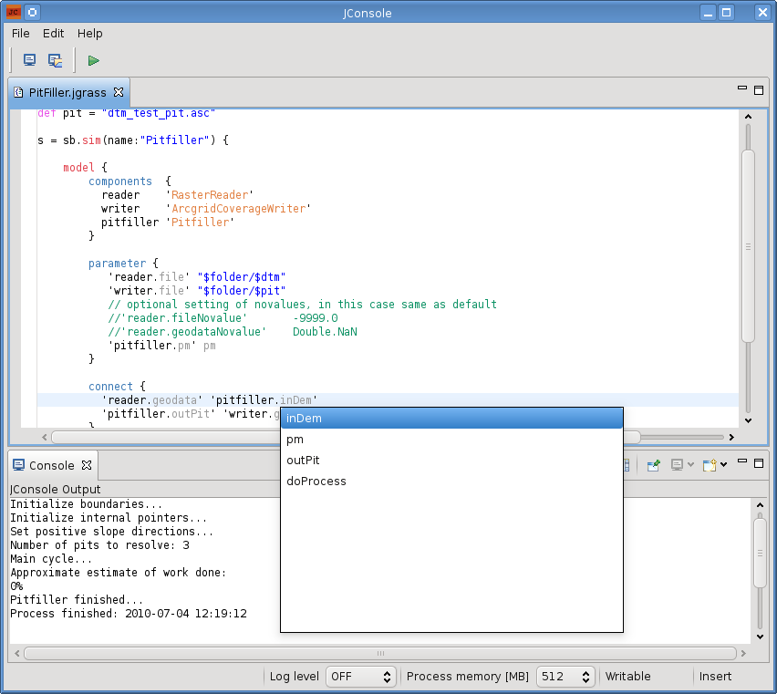
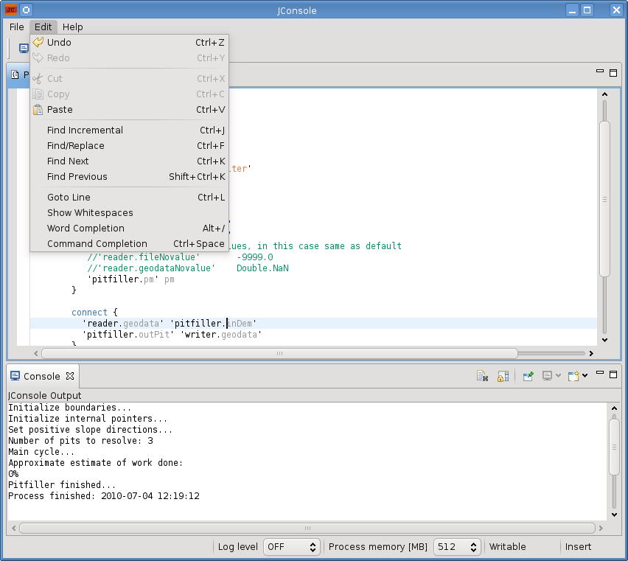
featurerich scripting editor:
simulation templates
syntax coloring for OMS3
command completion on modules
editor features like word completions, find, replace, IDE-like shortcuts for advanced and faster usage

Slide 35
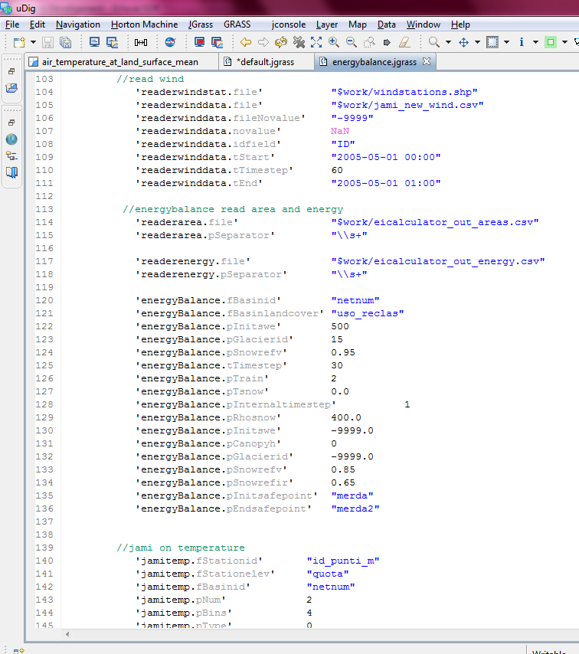
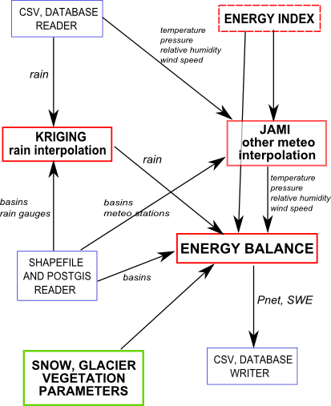
3) JGrass + OMS3 Geoprocessing / EnergyBalance

Slide 36
featurerich scripting editor:
simulation templates
syntax coloring for OMS3
command completion on modules
editor features like word completions, find, replace, IDE-like shortcuts for advanced and faster usage

Slide 37
CSIP / OMS

Slide 38
USDA-NRCS Science Delivery
USDA-NRCS
Conservationists
County level field offices
Consult directly with farmers
Models
Agency environmental models
Legacy desktop applications
Annual updates
Slow, restricted science delivery

Slide 39
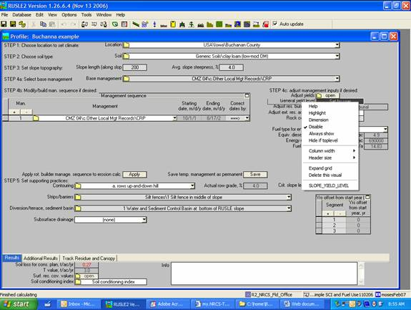

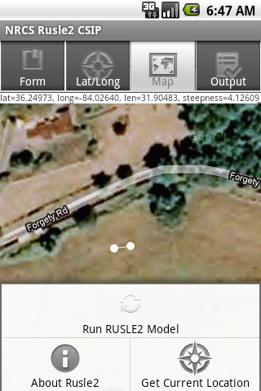
Rusle2 on CSIP

Slide 40
Cloud Services Innovation Platform
Model services architecture
Support science delivery
Desktop models → web services
IaaS cloud deployment
Scalable compute capacity:
For peak loads
Year end reporting
For compute intensive models
Watershed models
Rusle2
STIR
CSIP
WEPS
SCI
Watershed
Modeling

Slide 41
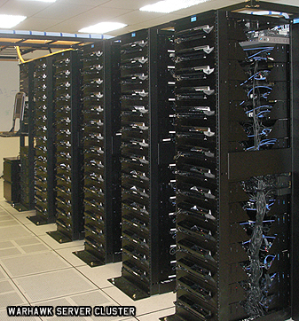
Eucalyptus Private Cloud(s)
Two eucalyptus clouds
ERAMSCLOUD
(9) Sun X6270 blade servers
Dual quad core CPUs, 24 GB ram
OMSCLOUD
Various commodity hardware
Eucalytpus 2.0.3
Amazon EC2 API support
Managed mode network w/ private VLANs, Elastic IPs
Dual boot for hypervisor switching
Ubuntu (KVM), CentOS (XEN)

Slide 42
CSIP Model Services
Multi-tier client/server application
RESTful webservice, JAX-RS/Java w/ JSON
App Server
Apache Tomcat
Geospatial rDBMS
File Server
nginx
Logger & shared cache
memcached
30+ million shapes
1000k+ files, 5+GB
POSTGRESQL
OMS3
RUSLE2
POSTGIS
WEPS

Slide 43
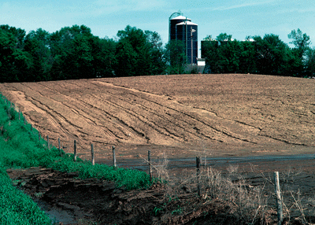
RUSLE2 Model
“Revised Universal Soil Loss Equation”
Combines empirical and process-based science
Prediction of rill and interrill soil erosion resulting from rainfall and runoff
USDA-NRCS agency standard model
Used by 3,000+ field offices
Helps inventory erosion rates
Sediment delivery estimation
Conservation planning tool

Slide 44
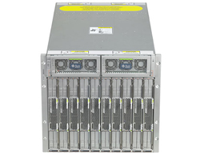
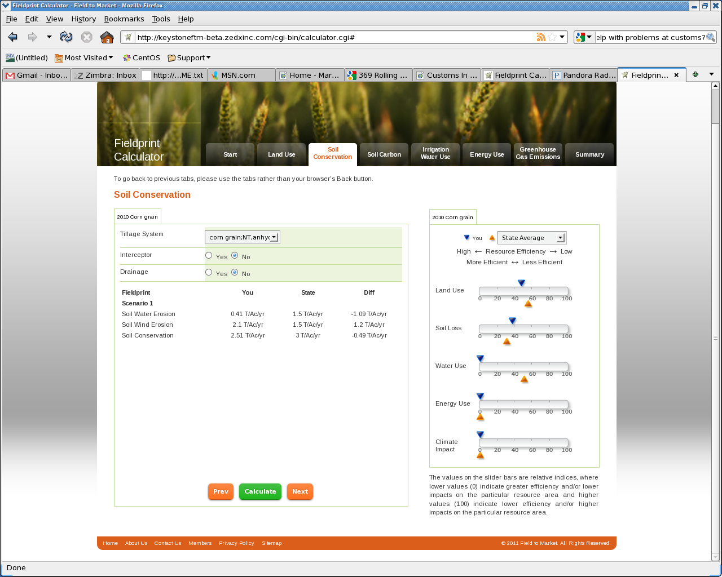

CSIP Cloud
CSU / NRCS / ARS Collaboration
Innovative model technology deployment
High scalability of modeling resources
OMS Models as service
Commercial cloud migration

Slide 45
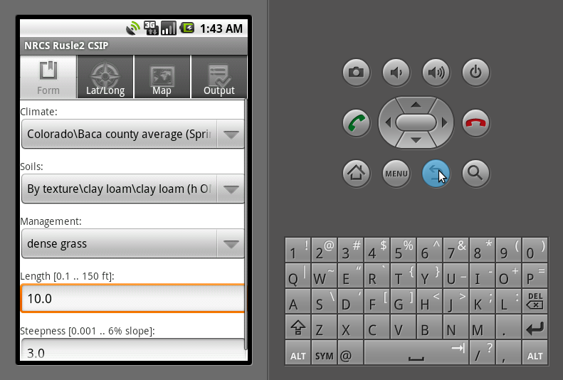
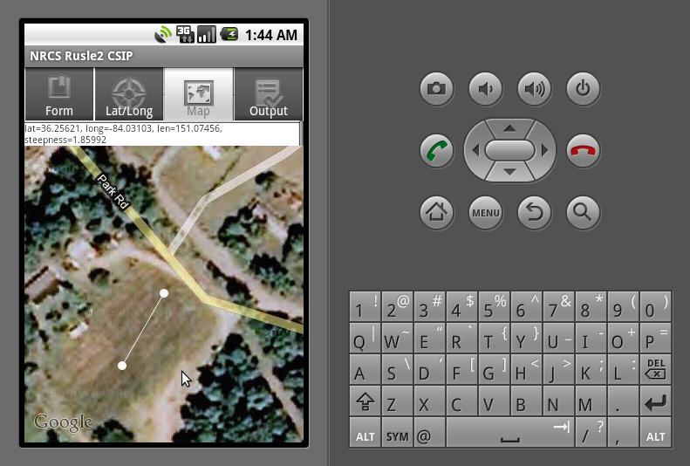
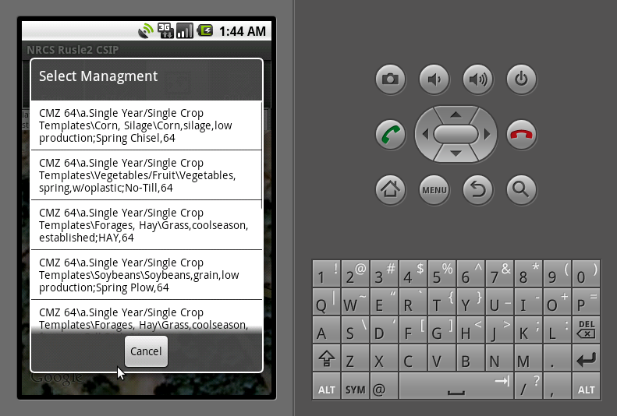
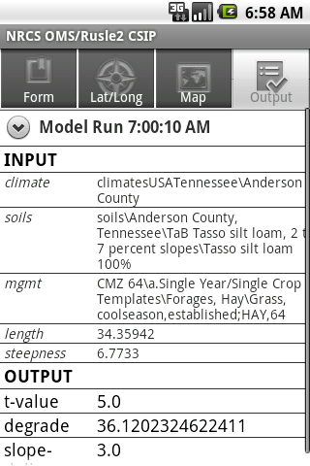
Rusle2 Mobile POC
Manual
Parameter
Selection
Transect
Definition
USGS
Elevation
service
Location based
Management
Selection
Remote Model
Execution
of Rusle 2 in
CSIP/OMS3
Model
Results

Slide 46
Water Balance Model - IAEA

Slide 47
Mainstreaming Groundwater Considerations into the Integrated Management of the Nile River Basin
4) UN Development Program Global Environment Facility Project
Governments of Burundi, DR Congo, Egypt, Ethiopia, Kenya, Rwanda, Sudan, Tanzania and Uganda
International Atomic Energy Agency
(G.H. Leavesley)
Provide the scientific basis and necessary institutional and policy support for incorporating a groundwater dimension into planning and management of the Nile basin ecosystem as an essential component of sustainable development of the Nile Basin.

Slide 48
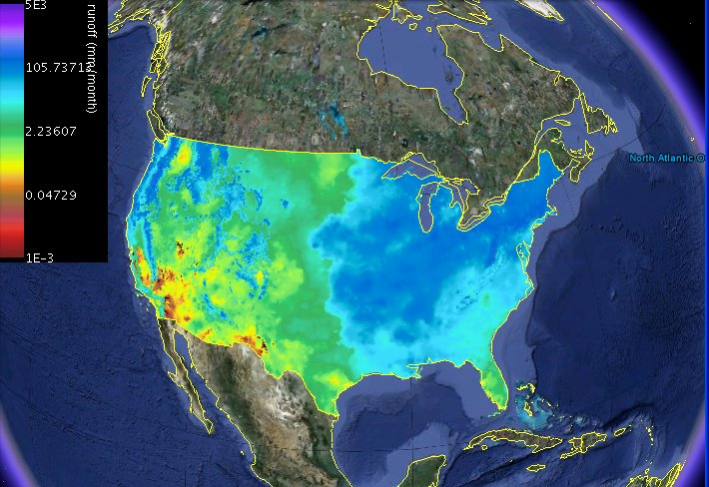
National Water Balance Model
Greg McCabe, USGS, Denver, CO
Dave Wolock, USGS, Lawrence, KS

Slide 49
McCabe Monthly Water Balance Model in OMS3
With Isotopes
Temperature
δO¹⁸ and δH²
Precipitation
δ_precip
Potential Evapotranspiration
δ_evap
Snow
δ_droff
Actual
Evapotranspiration
Snow Melt
Rain
Snow
Storage
Direct Runoff
δ_gw
Surplus Runoff
δ_sm2gw
Soil-Moisture Storage Capacity
δ_gwflow
δ_sm
Soil-Moisture Storage

Slide 50
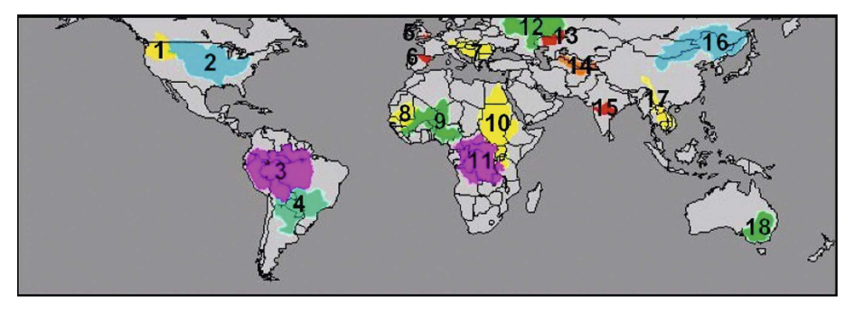
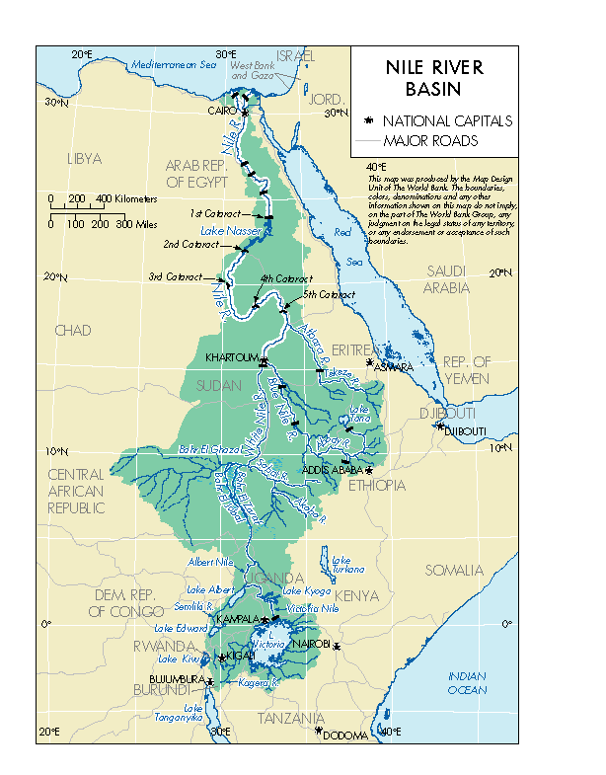
McCabe-Wolock Water Balance Model Global Application to …
Understand extent and impact of groundwater on selected rivers systems of Nile.
Assess the contribution of groundwater in sustaining wetlands in selected areas.
Integrate groundwater considerations into Nile basin planning and management activities.
…

Slide 51
OMS3 for WSF at the NWCC

Slide 52
Water Supply Forecasting
OMS3 implementation of PRMS (USGS) model
~30 process components
Added
Ensemble Streamflow Prediction
Detrended Kriging
Batch processing

Slide 53
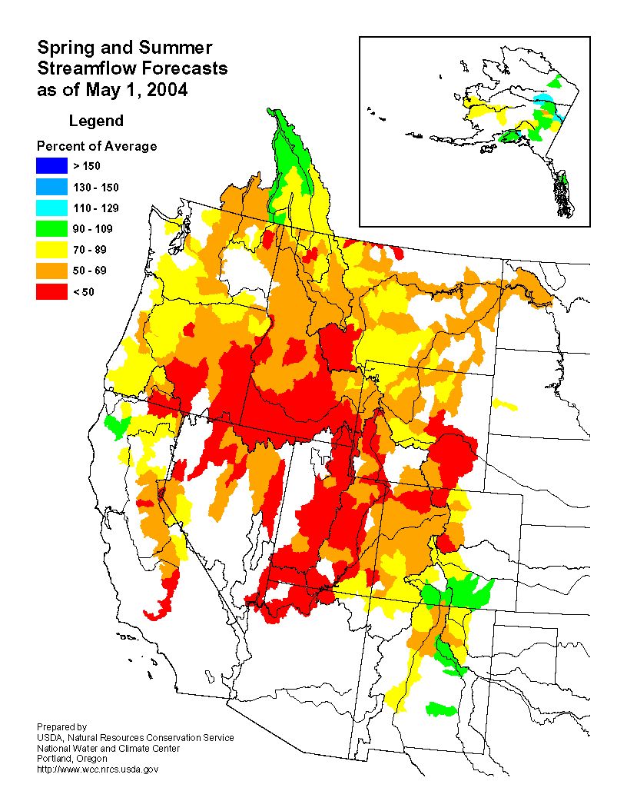
2) Water Supply Forecasts
Distributed by the NWCC
http://www.wcc.nrcs.usda. gov/wsf/wsf.html
Combined product of NWCC and National Weather Service Forecasts

Slide 54
Forecasts
Historically
seasonal, regression-equation based forecasts of estimated seasonal streamflow volume
Implementation
augment seasonal, regression-equation based water supply forecasts with forecasts based on the use of distributed-parameter, physical process hydrologic model OMS3/PRMS and an Ensemble Streamflow Prediction (ESP) approach.

Slide 55
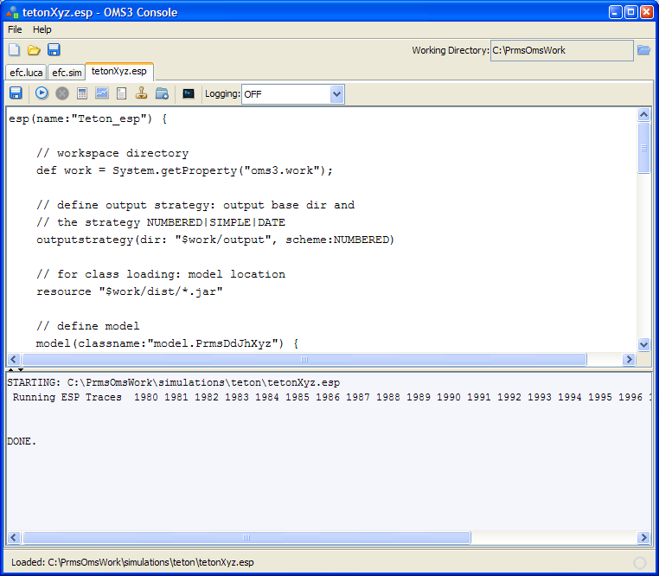
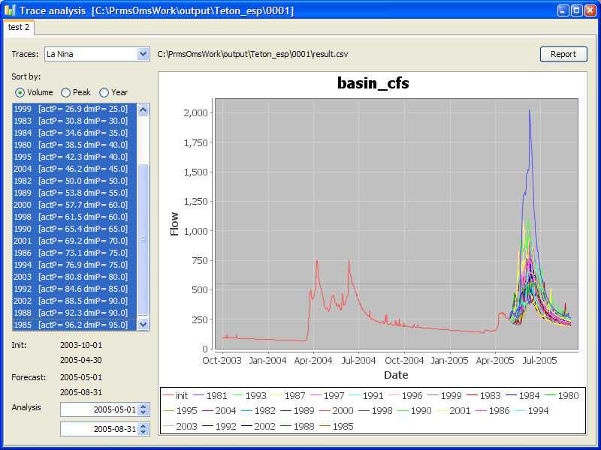
OMS3/ESP DSL and Trace Analysis
Stand-Alone or Multiple Batch

Slide 56

ESP NWCC 2013 Forecasting
All basins
ACIS
Batch Station Data Update
Incremental update, (QA/QC)
SNOTEL
QSTA
Batch ESP
Run OMS3/ESP
Creates raw forecasts for selected probability of exceedence values
Batch Debias
Uses regression coefficients from Debias_ESP to adjust raw forecast values
Debias_ESP:
Develop linear regression coefficients to adjust raw ESP forecasts
Run for each forecast
Run once a year

Slide 57
Debias ESP
Run ESP for each year in the historic data file (eg. 1981 -2010)
Sort traces for each forecast ensemble, excluding forecast year
Plot median ensemble forecast volume against observed volume
Run linear regression to get debias coefficients

Slide 58
Batch ESP
Create batch configuration file
Lists all basins to run and the forecast period
Update model data files to current date
Update begins at start of current water year to accommodate possible data edits
File data.csv stored in data/<basin_name>
Run ESP on each basin
Uses <basin_name>.esp
Create summary.csv output file and store in forecast/<basin_name>
Run ForecastRaw.java against summary.csv
generates raw forecasts for selected probabilities of exceedence (eg. 90, 70, 50, 30, 10)
applies regression coefficients from Debias_ESP to adjust raw forecast values
Creates the file fc_<forecast_date>.csv stored in forecast/<basin_name>
contains the raw and debiased forecast values for the selected probabilities of exceedence

Slide 59
OMS3 - NIFA/NSF

Slide 60
Assessing Water Management Tradeoffs and Targets under Climatic and Land Use Uncertainty
NIFA/NSF Water Sustainability and Climate
Kickoff Meeting, August 28, 2012
PI Mazdak Arabi (CSU)

Slide 61
Project Goal
The overarching goal of this project is to develop a new integrative and adaptive analysis framework for the development of optimal strategies for sustainable water management at the regional scale under projected future climate, land use and energy scenarios.

Slide 62
Study Area

Slide 63
The Overarching Framework

Slide 64
Objectives
To determine the changes in fluxes of water, sediment, nutrients (C, N, P), and salinity over the course of the next several decades at a daily time step from field to watershed-scale in response to changes in climate, land use, and management decisions.
To assess the feasibility of meeting projected water demands and water quality targets under the prevailing governance and institutional agreements and projected climate scenarios.

Slide 65
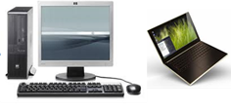
The Infrastructure
OMS
DAYCENT
SWMM/
IUWM
SWAT
MODFLOW
Forcing Scenarios
eRAMS
Custom UI
Geospatial data
GIS services
Analytics

Slide 66
Expected Outcomes
The novel framework and open-source modeling/ optimization infrastructure
Five PhD dissertations
Scientific papers and presentations
Final report focusing on dissemination of most important finding and recommendations to stakeholders in the region
Annual reports
Website for dissemination of the results

Slide 67
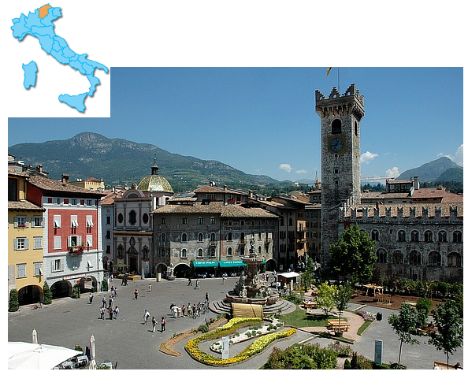

Hydrological modelling with components:
the OMS3 NewAge-JGrass system
G. Formetta
Supervisors:
O. David
R. Rigon
Formetta G., University of Trento (Italy)

Slide 68
Motivation
Basin Delineation
Hydrological Components
Conclusions
Outline
Model presentation
Description and application of hydrological components:
Short Wave Radiation Balance component
Snow Water Equivalent component
Runoff and Routing components
Conclusion
Formetta G., University of Trento (Italy)
Formetta G., ARS-USDA-Fort Collins (CO)

Slide 69
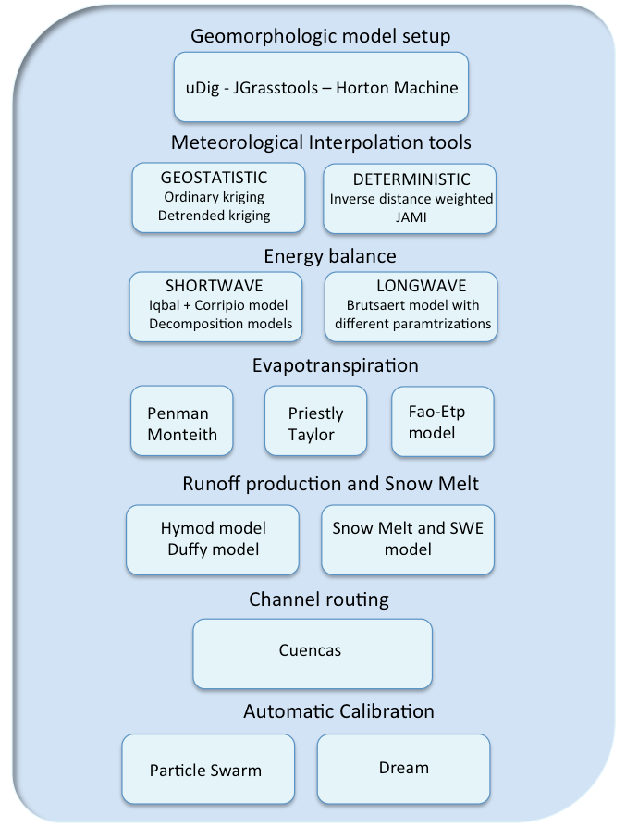
Motivation
Basin Delineation
Hydrological Components
Conclusions
JGrass-NewAge: a component and GIS based model
G. Formetta,
Trento 17 June 2011
G. Formetta,
Rome 09 March 2011
Leipzig 05 July 2012
Formetta G., University of Trento (Italy)
Notes:
Alcuni hanno fatto oms, altri la struttura informatica e infine io mi sn messo in mezzo

Slide 70
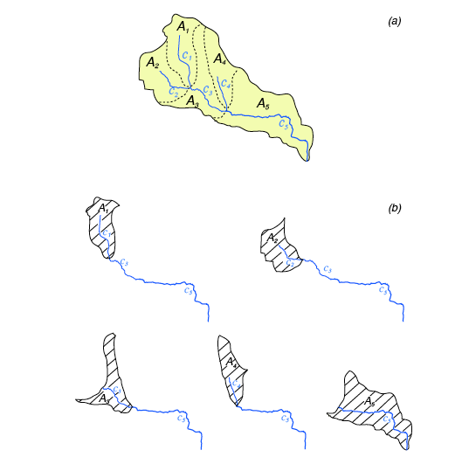
Motivation
Hydrological Components
Informatic Structure
Outline
Motivation
Hydrological Component
Hydrological Components
Calibration Issues
Conclusions
Outline
Basin Delineation
Data Assimilation
Conclusions
Hillslope-link partition of the basin
For each hillslope estimate:
mean rainfall
mean radiation
mean evapotranspiration
mean snow cover
mean runoff production
Rinaldo, Geomorphic Flood Research, 2006
G. Formetta,
Trento 17 June 2011
G. Formetta,
Rome 09 March 2011
Leipzig 05 July 2012
Trento 14 June 2012
Trento 24 June 2011
Formetta G., University of Trento (Italy)
Formetta G., ARS-USDA-Fort Collins (CO)

Slide 71
Motivation
Hydrological Components
Informatic Structure
Outline
Motivation
Hydrological Component
Hydrological Components
Calibration Issues
Conclusions
Outline
Basin Delineation
Data Assimilation
Conclusions
Model setup
Input data:
Raster: DTM - Vector: hydrometers - Parameters
Flow-directions
Drain-directions
Total Contributing Areas
Markoutlet
Hacklength
Extract Network
Hackstream
NetNumbering
Basin-shape
Pfafstetter
Jgrass-tools
JGrass
Basin split in hillslopes
Network split in links
Connected by a common key for routing
G. Formetta,
Trento 17 June 2011
G. Formetta,
Leipzig 05 July 2012
Trento 24 June 2011
Formetta G., University of Trento (Italy)
Formetta G., ARS-USDA-Fort Collins (CO)

Slide 72
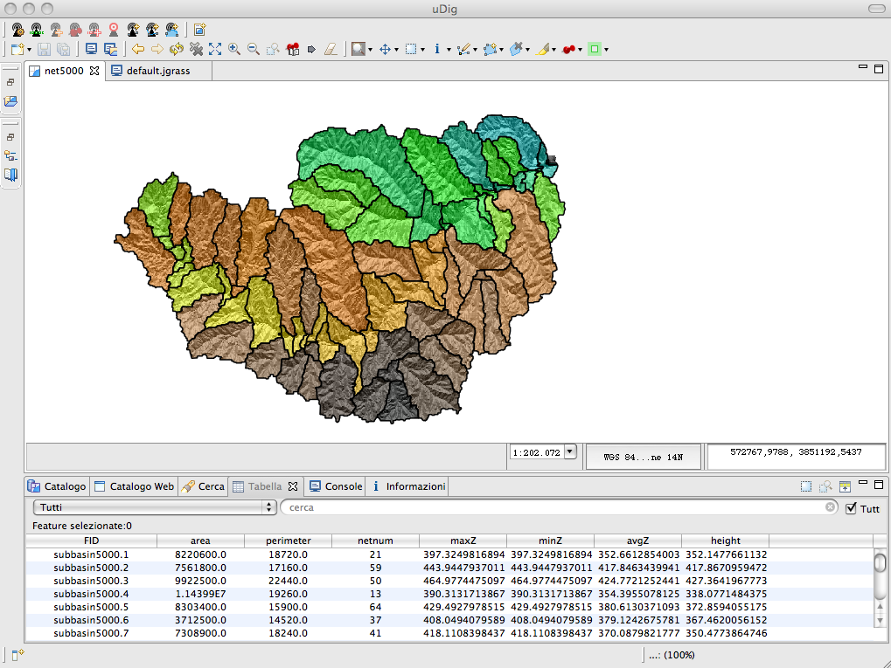
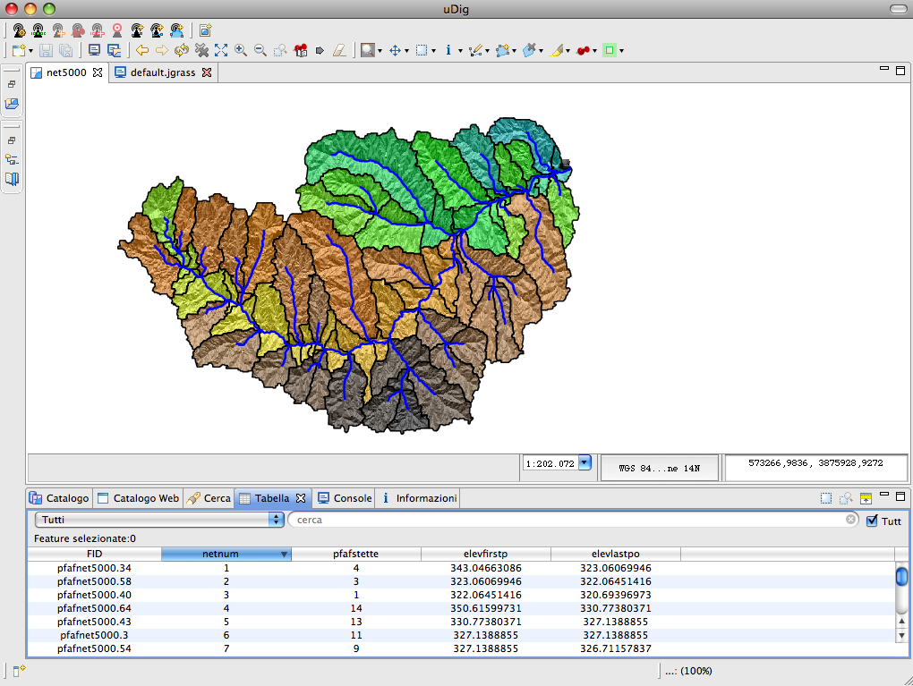
Motivation
Hydrological Components
Informatic Structure
Outline
Motivation
Hydrological Component
Hydrological Components
Calibration Issues
Conclusions
Outline
Basin Delineation
Data Assimilation
Conclusions
Model setup
Basin split
in hillslopes
Network split
in links
G. Formetta,
Trento 17 June 2011
G. Formetta,
Leipzig 05 July 2012
Trento 24 June 2011
Formetta G., University of Trento (Italy)
Formetta G., ARS-USDA-Fort Collins (CO)

Slide 73
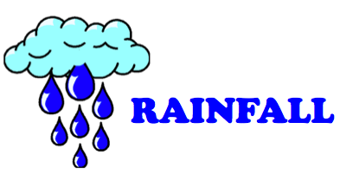




Motivation
Hydrological Components
Informatic Structure
Outline
Outline
Motivation
Hydrological Component
Hydrological Components
Hydrological Components
Calibration Issues
Calibration Issues
Conclusions
Outline
Basin Delineation
Data Assimilation
Informatic Structure
Conclusions
Meteorological Forcing Input
ESSENTIALS
G. Formetta,
Trento 17 June 2011
G. Formetta,
Leipzig 05 July 2012
Trento 24 June 2011
Formetta G., University of Trento (Italy)
Formetta G., ARS-USDA-Fort Collins (CO)

Slide 74

Motivation
Hydrological Components
Informatic Structure
Outline
Outline
Motivation
Hydrological Component
Hydrological Components
Hydrological Components
Calibration Issues
Calibration Issues
Conclusions
Outline
Basin Delineation
Data Assimilation
Informatic Structure
Conclusions
Interpolation Problem
Interpolation Algorithm: Krigings
Variogram + Fit.Variogram
Estimation of experimental semivariogram
Ordinary Kriging
Detrended Kriging
Theoretic semivariogram parameter estimation, select the best of 6 models.
Interpolation Algorithm: JAMI
Split in altimetric band
Look for the closest stations
Interpolate according to the meteorological forcing and the number of stations
G. Formetta,
Trento 17 June 2011
G. Formetta,
Leipzig 05 July 2012
Trento 24 June 2011
Formetta G., University of Trento (Italy)
Formetta G., ARS-USDA-Fort Collins (CO)

Slide 75
Motivation
Motivation
Hydrological Component
Hydrological Components
Outline
Basin Delineation
Calibration Issues
Data Assimilation
Conclusions
Energy Model
Why…?
Net radiation estimate
Evapotranspiration estimate
Snow modelling
Vegetation modelling
How…?
Vector mode (computation only for some points)
Raster mode (computation for each pixel)
G. Formetta,
Trento 17 June 2011
G. Formetta,
Trento 24 June 2011
Formetta G., University of Trento (Italy)
Formetta G., ARS-USDA-Fort Collins (CO)
G. Formetta,
Trento 24 Oct 2011

Slide 76

Motivation
Motivation
Hydrological Component
Hydrological Components
Outline
Basin Delineation
Calibration Issues
Data Assimilation
Conclusions
Shortwave Energy Model
Solar radiation under cloudless condition
For each pixel i and for each time t:
direct
diffuse
reflected
Solar radiation under generic sky condition
Solar radiation under cloudless condition
Cloud based coefficient multiplier
Decomposition models
Measured incoming solar shortwave radiation
G. Formetta,
Trento 17 June 2011
G. Formetta,
Trento 24 June 2011
Formetta G., University of Trento (Italy)
Formetta G., ARS-USDA-Fort Collins (CO)
G. Formetta,
Trento 24 Oct 2011

Slide 77


Motivation
Basin Delineation
Hydrological Components
Conclusions
Piave river basin (Italy)
Little Washita river basin (US)
Formetta G., University of Trento (Italy)
Formetta G., ARS-USDA-Fort Collins (CO)

Slide 78
Motivation
Hydrological Components
Informatic Structure
Outline
Outline
Motivation
Hydrological Component
Hydrological Components
Hydrological Components
Calibration Issues
Calibration Issues
Conclusions
Outline
Basin Delineation
Data Assimilation
Informatic Structure
Conclusions
Snow Melt and SWE model
Improved concepts as presented in Cazorzi and Della Fontana, 1996 and Kokkonen et al., 2006
Precipitation Form
Snow Melt
Freezing
Mass Balance
WE ice
WE water
G. Formetta,
Trento 17 June 2011
G. Formetta,
Leipzig 05 July 2012
Trento 24 June 2011
Formetta G., University of Trento (Italy)
Formetta G., ARS-USDA-Fort Collins (CO)

Slide 79





Motivation
Hydrological Components
Informatic Structure
Outline
Outline
Motivation
Hydrological Component
Hydrological Components
Hydrological Components
Calibration Issues
Calibration Issues
Conclusions
Outline
Basin Delineation
Data Assimilation
Informatic Structure
Conclusions
Snow Melt and SWE model
G. Formetta,
Trento 17 June 2011
G. Formetta,
Leipzig 05 July 2012
Trento 24 June 2011
Formetta G., University of Trento (Italy)
Formetta G., ARS-USDA-Fort Collins (CO)

Slide 80

Motivation
Basin Delineation
Hydrological Components
Conclusions
Snow Melt and SWE model
SWE-Model: raster mode
Detrended kriging interpolation for precipitation and air temperature
Parameter set equals to the mean value of the three parameter sets previously estimated.
Formetta G., University of Trento (Italy)
Formetta G., ARS-USDA-Fort Collins (CO)

Slide 81


Motivation
Hydrological Components
Informatic Structure
Outline
Outline
Motivation
Hydrological Component
Hydrological Components
Hydrological Components
Calibration Issues
Calibration Issues
Conclusions
Outline
Basin Delineation
Data Assimilation
Informatic Structure
Conclusions
Runoff Production: HyMod
✔
Few parameters: only 5
Very fast
✗
Lumped model
Channel routing
Dissecting the effect of rainfall variability on the statistical structure of peak flows, Mandapaka et al., Advances in Water Resources 2009
Mantilla R. Physical basis of statistical self-similarity in peak ﬂows on random self-similar networks. PhD dissertation, University of Colorado, Boulder; 2007.
G. Formetta,
Trento 17 June 2011
G. Formetta,
Leipzig 05 July 2012
Trento 24 June 2011
Formetta G., University of Trento (Italy)
Formetta G., ARS-USDA-Fort Collins (CO)
Notes:
Cambiare fashion

Slide 82




Motivation
Hydrological Components
Informatic Structure
Outline
Outline
Motivation
Hydrological Component
Hydrological Components
Hydrological Components
Calibration Issues
Calibration Issues
Conclusions
Outline
Basin Delineation
Data Assimilation
Informatic Structure
Conclusions
A
B
G. Formetta,
Trento 17 June 2011
G. Formetta,
Leipzig 05 July 2012
Trento 24 June 2011
Formetta G., University of Trento (Italy)
Formetta G., ARS-USDA-Fort Collins (CO)

Slide 83

Motivation
Hydrological Components
Informatic Structure
Outline
Outline
Motivation
Hydrological Component
Hydrological Components
Hydrological Components
Calibration Issues
Calibration Issues
Conclusions
Outline
Basin Delineation
Data Assimilation
Informatic Structure
Conclusions
G. Formetta,
Trento 17 June 2011
G. Formetta,
Leipzig 05 July 2012
Trento 24 June 2011
Formetta G., University of Trento (Italy)
Formetta G., ARS-USDA-Fort Collins (CO)

Slide 84


GEOtop/OMS3 - Model Integration and Case Study.
Formetta G. et al., University of Trento (Italy)

Slide 85
Outline
OMS3
GEOtop
GOALS
Application
Outline
GEOtop and Object Modelling System
Goals of the integration
Application and Conclusion
Formetta G., University of Trento (Italy)
Formetta G., ARS-USDA-Fort Collins (CO)

Slide 86

Outline
OMS3
GEOtop
GOALS
Application
What and Why OMS3?
The Object Modeling System OMS is a modular modeling framework that, using an open source software approach, enables all members of the scientific community to address collaboratively the many complex issues associated with the design, development, and application of distributed hydrological and environmental models.
GOALS
Component interoperability
Data interoperability
Language interoperability
G. Formetta,
Trento 17 June 2011
G. Formetta,
Rome 09 March 2011
Leipzig 05 July 2012
Formetta G., University of Trento (Italy)
Notes:
Alcuni hanno fatto oms, altri la struttura informatica e infine io mi sn messo in mezzo

Slide 87




Motivation
Outline
GEOtop
Hydrological Components
Basin Delineation
GOALS
OMS3
Conclusions
Application
What and Why OMS3?
PRMS
AgroEcoSystem-Watershed
NewAge
Console for script execution
uDig-Jgrass GIS integration
LUCA
Particle Swarm
DREAM
G. Formetta,
Trento 17 June 2011
G. Formetta,
Rome 09 March 2011
Leipzig 05 July 2012
Formetta G., University of Trento (Italy)
Notes:
Alcuni hanno fatto oms, altri la struttura informatica e infine io mi sn messo in mezzo

Slide 88
Motivation
Outline
GEOtop
Hydrological Components
Outline
GEOtop
Application
Basin Delineation
GOALS
OMS3
Conclusions
Conclusions
OMS3
Application
What and Why OMS3?
PRMS
AgroEcoSystem-Watershed
NewAge
Console for script execution
uDig-Jgrass GIS integration
March 26 2:00 pm Evapotranspiration - Crop Water Use - Crop Yield:
3:30: Testing a new channel routing component in JGrass-NewAge model Giuseppe Formetta et al.
LUCA
Particle Swarm
DREAM
G. Formetta,
Trento 17 June 2011
G. Formetta,
Rome 09 March 2011
Leipzig 05 July 2012
Formetta G., University of Trento (Italy)
Notes:
Alcuni hanno fatto oms, altri la struttura informatica e infine io mi sn messo in mezzo

Slide 89


Motivation
Hydrological Components
Informatic Structure
Outline
Motivation
Outline
Hydrological Component
GEOtop
Hydrological Components
Calibration Issues
Conclusions
Outline
Basin Delineation
GOALS
Data Assimilation
OMS3
Conclusions
Application
GEOtop model
3D physically based finite-difference model
spatially distributed
It models:
- subsurface saturated and unsaturated flows
- surface runoff
- turbulent fluxes across the soil-atmosphere interface.
G. Formetta,
Trento 17 June 2011
G. Formetta,
Rome 09 March 2011
Leipzig 05 July 2012
Trento 14 June 2012
Trento 24 June 2011
Formetta G., University of Trento (Italy)
Formetta G., ARS-USDA-Fort Collins (CO)

Slide 90



Motivation
Hydrological Components
Informatic Structure
Outline
Motivation
Outline
Hydrological Component
GEOtop
Hydrological Components
Calibration Issues
Conclusions
Outline
Basin Delineation
GOALS
Data Assimilation
OMS3
Conclusions
Application
Model integration goals n.1: enjoy the GIS uDig-JGrass
GEOtop
OMS3
G. Formetta,
Trento 17 June 2011
G. Formetta,
Leipzig 05 July 2012
Trento 24 June 2011
Formetta G., University of Trento (Italy)
Formetta G., ARS-USDA-Fort Collins (CO)

Slide 91

Motivation
Hydrological Components
Informatic Structure
Outline
Motivation
Outline
Hydrological Component
GEOtop
Hydrological Components
Calibration Issues
Conclusions
Outline
Basin Delineation
GOALS
Data Assimilation
OMS3
Conclusions
Application
Model integration goals n.2: enjoy calibration algorithms
Measured data
GEOtop
OMS3
G. Formetta,
Trento 17 June 2011
G. Formetta,
Leipzig 05 July 2012
Trento 24 June 2011
Formetta G., University of Trento (Italy)
Formetta G., ARS-USDA-Fort Collins (CO)

Slide 92

Motivation
Hydrological Components
Informatic Structure
Outline
Motivation
Outline
Hydrological Component
GEOtop
Hydrological Components
Calibration Issues
Conclusions
Outline
Basin Delineation
GOALS
Data Assimilation
OMS3
Conclusions
Application
Model Application
Tuostolo river basin
Measurement station
G. Formetta,
Trento 17 June 2011
G. Formetta,
Leipzig 05 July 2012
Trento 24 June 2011
Formetta G., University of Trento (Italy)
Formetta G., ARS-USDA-Fort Collins (CO)

Slide 93


Motivation
Hydrological Components
Informatic Structure
Outline
Motivation
Outline
Hydrological Component
GEOtop
Hydrological Components
Calibration Issues
Conclusions
Outline
Basin Delineation
GOALS
Data Assimilation
OMS3
Conclusions
Application
Model Application
Tuostolo river basin
Measurement station
G. Formetta,
Trento 17 June 2011
G. Formetta,
Leipzig 05 July 2012
Trento 24 June 2011
Formetta G., University of Trento (Italy)
Formetta G., ARS-USDA-Fort Collins (CO)

Slide 94
Motivation
Hydrological Components
Informatic Structure
Outline
Motivation
Outline
Hydrological Component
GEOtop
Hydrological Components
Calibration Issues
Conclusions
Outline
Basin Delineation
GOALS
Data Assimilation
OMS3
Conclusions
Application
Model Application
Suction [KPa] simulation at 0.35 m depth
Simulation period:
01-12-2007 to 01-05-2008
Time step: hourly
PBIAS=1.90
NSE=0.83
G. Formetta,
Trento 17 June 2011
G. Formetta,
Leipzig 05 July 2012
Trento 24 June 2011
Formetta G., University of Trento (Italy)
Formetta G., ARS-USDA-Fort Collins (CO)

Slide 95
Motivation
Hydrological Components
Informatic Structure
Outline
Motivation
Outline
Hydrological Component
GEOtop
Hydrological Components
Calibration Issues
Conclusions
Outline
Basin Delineation
GOALS
Data Assimilation
OMS3
Conclusions
Application
Model Application
Soil moisture simulation at 0.35 m depth
Simulation period:
01-12-2007 to 01-05-2008
Time step: hourly
PBIAS=2.1
NSE=0.70
G. Formetta,
Trento 17 June 2011
G. Formetta,
Leipzig 05 July 2012
Trento 24 June 2011
Formetta G., University of Trento (Italy)
Formetta G., ARS-USDA-Fort Collins (CO)

Slide 96
Motivation
Hydrological Components
Informatic Structure
Outline
Motivation
Outline
Hydrological Component
GEOtop
Hydrological Components
Calibration Issues
Conclusions
Outline
Basin Delineation
GOALS
Data Assimilation
OMS3
Conclusions
Application
Conclusion
GEOtop model integration in the OMS3 framework brings many benefits:
GIS integration for input output data
Model parameter calibration
OMS3 implicit processes parallelization
First model application provides good results
Open questions are:
Simulation of the hydrological variable in the deepest layers
Model parameter calibration
Multisite and multidata calibration
G. Formetta,
Trento 17 June 2011
G. Formetta,
Leipzig 05 July 2012
Trento 24 June 2011
Formetta G., University of Trento (Italy)
Formetta G., ARS-USDA-Fort Collins (CO)

Slide 97
OMS Laboratory
Established July 2011 as organization within the CSU Department of Civil and Environmental Engineering
Purpose: maintain and facilitate the further development and use of the OMS platform: modeling framework, data provisioning, model/data service hosting, and model/data content management (knowledge base) through collaborations among participating organizations
Charter collaborators: CSU, USDA-ARS, USDA-NRCS
Services: model development, model/data service hosting, training, OMS platform maintenance/enhancement

Slide 98
OMSLab Collaborations
NRCS Water and Climate Center next generation water supply forecasting system based on the USGS precipitation and runoff (PRMS) model deployed to the OMS platform – CSU/NRCS
OMS erosion model service hosting supporting the Keystone Center Field to Market Initiative – CSU/ZedX
Groundwater modeling in the Nile Basin using the OMS-IAEA water balance model (based on McCabe/Wolock) – CSU/IAEA
OMS resource analysis model services (erosion, soil organic matter depletion) for the Conservation Desktop of the NRCS Conservation Delivery Streamlining Initiative – CSU/NRCS
Development of the AgES-Watershed agro-ecosystem model – CSU/ARS
OMS-based hydrologic modeling in Europe – CSU/HydroloGIS/University of Trento
Joint workshop on OMS and BioMA with EU-MARS project
OMS training to crop modelers – CSU/DSSAT Foundation/ARS
OMS training to social science modelers – CSU/US Army COE

Slide 99
Component Development

Slide 100
OMS3
OMS 3
Component-based
lightweight (non-invasive)
Dataflow driven execution
Defaults to multithreaded execution of components.
Notes:
Emphasize the real costs of transitioning between different kinds of processing (GIS & ESMs).
Consistent structure for modeling and all of its related activities.

Slide 101
OMS2 & OMS3
What is common?
Conceptually similar, Init/Run/Cleanup
What is different?
No Framework data types in OMS3
No interfaces provided by OMS3
Default Multithreading in OMS3
NGMF Annotated POJOS vs. OMS2 API Interface implementations

Slide 102
A Component
input(s)
output(s)
processing

Slide 103
Example Component (cont.)
@Description(“Circle computation”)
@Author(“od”)
public class CircleArea {
@Description(“Radius”)
@Range(min=0)
@In public double r;
@Out public double area;
@Execute public void runme(){ area = Math.PI * r * r;
}
}
radius
area
CircleArea

Slide 104
IRF Phases
@Initialize
@Execute
optional
Iteration
@Execute
@Execute
@Finalize

Slide 105
Component
Simple Example component. Any Plain Old java Object (POJO) is a component in NGMF.
public class Component { ...
}
Public component class
Default public , non argument constructor. It can be omitted if there is no other constructor given.
No need to subclass or implement interfaces.
Component
=
POJO + Meta data

Slide 106
Meta data purpose
Execution control and connectivity
Execution support
Documentation/Repository support
Testing support
Runtime consistency support

Slide 107
Meta Data
C
F
M
Component
Field
Method
@Description
@Author
@Bibliography
@Status
@VersionInfo
@SourceInfo
@Keywords
@Label
@Description
@Unit
@In
@Out
@Range
@Role
@Bound
@Label
@Execute
@Initialize
@Finalize

Slide 108
Description
C,F
A component with more descriptive information.
@Description(“Circle Area Calculation.”)
public class CircleArea {
@Description (“Radius”)
@In public double r; ...
}
Tag the Component and the fields being used for input and output with the @Description annotation.
This is optional metadata.

Slide 109
Author
C
Simple Example component with author information.
@Author(
name="Joe Scientist",
org=“Joe’s Research Org",
contact="joe.scientist@research-org.edu")
public class ET {
}
@Author provides some contact information.
Attribute name is mandatory, org and contact are optional

Slide 110
Bibliography
C
Example component with Bibliography information.
@Description(“Circle Area Calculation.”)
@Bibliography(“Journal of Geometry, Vol.1, p..”)
public class CircleArea { ...
}
Attach a @Bibliography annotation to a component to refer to Literature background, Web sites that contain detailed documentation, etc.
This annotation does have the same purpose like a Bibliography list in a scientific paper.
Each reference is a separate string, multiple references are comma separated.
This is optional metadata and can be used to document components.

Slide 111
Status
C
Component with status information. A status is a component quality indicator.
@Description(“Circle Area Calculation.”)
@Status(Status.TESTED)
public class CircleArea { ...
}
Component have an optional status.
A developer can specify the level of completeness or maturity of a component with this tag.
Predefined values
DRAFT, SHARED, TESTED, VALIDATED, CERTIFIED
This is optional metadata and can be used to classify, verify stored components in a repository

Slide 112
VersionInfo
C
Simple Example component with version information. Can (Should) be used in conjunction with a VCS.
@VersionInfo(“$Id: ET.java 20 2008-07-25 22:31:07Z od $”)
public class ET {
}
@VersionInfo might contain more than just a number.
Version control systems such as CVS, Subversion, or Mercurial provide keyword substitution that present revision number, last modification time, or developer id.
@VersionInfo is optional but is good practice.
Component repositories can use and present this information
http://svnbook.red-bean.com/en/1.5/svn.advanced.props.special.keywords.html
http://www.selenic.com/mercurial/wiki/index.cgi/KeywordPlan

Slide 113
SourceInfo
C
Simple Example component with source information. Can (Should) be used in conjunction with a VCS.
@SourceInfo(“$HeadURL: http://www.test.org/repo/ET.java $”)
public class ET {
}
@SourceInfo provides some link to the source.
Version control systems such as CVS, Subversion, or Mercurial provide keyword substitution that fills in the Repository URL.
@SourceInfo is optional.
Component repositories can use and present this information
http://svnbook.red-bean.com/en/1.5/svn.advanced.props.special.keywords.html
http://www.selenic.com/mercurial/wiki/index.cgi/KeywordPlan

Slide 114
Keywords
C
Example component with descriptive information.
@Description(“Circle Area Calculation.”)
@Keywords(“Geometry, 2D”)
public class CircleArea { ...
}
Tag the Component with the @Keywords annotation to characterize it.
This annotation does have the same purpose like a Keyword list in a scientific paper.
This is optional metadata and can be used to index, search, and retrieve archived and stored components. It is optional meta data.

Slide 115
Label
C,F
Simple Example component with label information. Labels relate to ontologies (label is an OWL annotation)
public class Calc {
@Label(“latitude”) @In public double lat;
...
}
Labeling a field or component offers alternative names.
Labels might be used to relate components or fields to ontologies.
Labels are optional.
http://www.w3.org/TR/owl-ref/

Slide 116
Execute
M
Simple Example component with execution method. This method provides the implementation logic of the component where the input is being transformed to output.
public class Component { @Execute public void executemethod() { // execute code here }
}
Name the execution method any name you want, but annotate it with @Execute
The execute methods has to be non-static, public, void, no arguments.
This is required meta data

Slide 117
Initialize
M
Simple Example component with init method. In this method the internal state of a component should be initialized. (e.g. opening a file for reading)
public class Component { @Initialize public void start() { // initialization code }
}
Name the execution method any name you want, but annotate it with @Initialize
The init methods has to be non-static, public, void, and has no arguments.
This method gets called once after Component instantiation and before the first execution.
This is optional meta data

Slide 118
Finalize
M
Simple Example component with finalize method. This method provides the notion of a final cleanup after model execution (e.g. closing a DB connection)
public class Component { @Finalize public void cleanup() { // execute code here }
}
Name the finalization method any name you want, but annotate it with @Finalize
The method has to be non-static, public, void, and has no arguments.
Finalize overlaps with Java’s finalize() method that gets called from the garbage collector.
This is optional meta data

Slide 119
In & Out
F
Simple Example component with annotated I/O fields .
public class CircleArea { @In public double radius; @Out public double area; @Execute public void runme() { area = Math.PI * radius * radius; }
}
Tag the fields being used for input and output with @In and @Out
Fields can have any data type (primitive or objects) and should be public.
No arguments for @In and @Out
Required Meta data

Slide 120
Unit
F
Simple Example component with unit information.
public class Calc {
@Unit(“degree”) @In public double latitude;
...
}
Unit information for IO fields
Usually used for scalars and arrays.
Allows frameworks to support unit checking/validation and conversion
Optional Meta data.
http://jscience.org
http://www.jcp.org/en/jsr/detail?id=275

Slide 121
Ranges
F
Simple Example component with range information.
public class Calc {
@Unit(“degree”)
@Range(min = -90, max = 90) @In public double latitude;
...
}
Range information for valid input and output values.
Min and max inclusive.
Default value for min if omitted: Double.MinValue
Default value for max if omitted : Double.MaxValue

Slide 122
Ranges (cont.)
F
Uses cases for Range
@Range(min=0) // value has to be >=0
@Range(min=32, max=50)
Use cases
Runtime value exchange check
Component testing based on statistical data

Slide 123
Role
F
Field with role information. A role is a modeling concept such as a ‘parameter’ or ‘state variable’ that applies for a field.
public class ET {
@Description(“Jensen-Haise Coefficient”)
@Role(Role.Parameter)
@In public double jh_coeff; ...
}
Tag the Field with the @Role annotation to characterize its role in this component.
Choose from a predefined set: Role.Parameter, Role.Variable, Role.Simulated, Role.Observed) or create your own Role
A Role annotation takes a string argument.
This is optional meta data.

Slide 124
Bound
F
A field might have bound information. A bound defines a binding to another field. This could be a dimension for an array.
public class ET {
@Bound(“nsim”)
@In public double[] jh_coeff;
@In public int nsim; ...
}
A Bound annotation takes a string argument.
It allows a GUI to present dependencies between fields.
This is optional meta data.
Jh_coeff has the named dimension nsim.

Slide 125
Component Metadata Variants
3 different syntaxes to provide for the same Component meta data semantics using (i) Annotations or (ii) XML
Embedded Metadata using Annotations
Attached Metadata using Annotations
Attached Metadata using XML

Slide 126
1) Embedded Metadata Annotations
import ngmf.ann.*; // (1)
public class CircleArea { @In public double radius; // (2) @Out public double area; // (2)
@Execute public void runme() { area = Math.PI * radius * radius; // (3) }
}
CircleArea.java
The meta data is part of the component via Annotations
Must have access to source code

Slide 127
2) Attached Metadata Annotations
Two Separate files!
import ngmf.ann.*; // (1)
public abstract class CircleAreaCompInfo {
@In public double radius; // (2)
@Out public double area; // (2)
@Execute
public abstract void exec();
}
CircleAreaCompInfo.java
public class CircleArea {
public double radius;
public double area;
public void exec() {
area = Math.PI *
radius * radius;
}
}
CircleArea.java
POJO, no NGMF dependency
class/jar sufficient, no source required
Abstract Class (cannot run), abstract methods
Required ‘CompInfo’ Extension
Names for Component, fields and methods must match

Slide 128
3) Attached Metadata XML
public class CircleArea {
public double radius;
public double area;
public void exec() {
area = Math.PI *
radius * radius;
}
}
CircleArea.java
<CircleArea:Component>
<radius:In/>
<area:Out/>
<exec:Execute/>
</CircleArea:Component>
CircleAreaCompInfo.xml
POJO, no NGMF dependency
class/jar sufficient, no source required
XML namespaces for component and field name
Annotations → XML

Slide 129
3) Attached Metadata XML (cont)
@Description(“Groundwater Reservoirs”)
@Range(min=10, max=20)
@In public int ngwres;
...
<gwres:Description>
Groundwater Reservoirs
</gwres:Description>
<gwres:Range min=’10’ max=’20’/>
<gwres:In/>
Java Annotation – XML equivalence
Annotation Type name ↔ QName Local part
Field name ↔ QName Prefix
Annotation attribute ↔ Element Attribute
Annotation attribute value ↔ Element Attribute value
Annotation content ↔ Element PCDATA content
http://www.w3.org/TR/REC-xml/

Slide 130
Native code Access

Slide 131
What does it do?
Use FORTRAN code in OMS directly
No C/C++ bridge required!
Define OMS components in FORTRAN
Integrated with build system
Allow automatic documentation generation from source

Slide 132
Requirements
FORTRAN 90+ syntax
(MODULES notation)
ISO_C_BINDING
GCC 4.4+ / gfortran
OMS3.1+

Slide 133
Example
! @Execute
SUBROUTINE we(eroout, eroout_len,runoff,peakro,effdrn)
! @In
CHARACTER(kind = C_CHAR, len = eroout_len) :: eroout
INTEGER(C_INT), intent(in), VALUE :: eroout_len
! @In
REAL(C_FLOAT) :: runoff,peakro,effdrn
..
Annotations
(F2003+)
F90+ISO_C_BINDING constructs
Declaration part, no API

Slide 134
Annotations
! @Execute("we")
SUBROUTINE we(eroout, eroout_len, runoff,peakro,effdrn)
! @In
CHARACTER(kind = C_CHAR, len = eroout_len) :: eroout
INTEGER(C_INT), intent(in), VALUE :: eroout_len
! @In
REAL(C_FLOAT) :: runoff,peakro,effdrn
!
‘Hidden’ in language comments
optional arguments
Preceding the language construct
subroutine, function, argument, module

Slide 135
Annotations
Annotations = meta data for source elements
No arguments
@In
Single Value Argument
@Execute(“Erosion”)
Named argument(s)
@Description(en=“Erosion module”, de=“Erosionsmodul”)

Slide 136
ISO_C_BINDING
C Interoperability for FORTRAN
Data type mapping
C_DOUBLE
C_FLOAT
C_CHAR
C_BOOL

Slide 137
@Execute
! @Execute
SUBROUTINE we(eroout, eroout_len, runoff,peakro,effdrn)
@Execute defines entry point

Slide 138
Input
! @Description("Erosion output name")
! @In
CHARACTER(kind = C_CHAR, len = eroout_len) :: eroout
INTEGER(C_INT), VALUE :: eroout_len
@In input to the subroutine
Multiple annotations possible, one per line

Slide 139
CHARACTER
! @Execute("we")
SUBROUTINE we(eroout, eroout_len, ...
! @In
CHARACTER(kind = C_CHAR, len = eroout_len) :: eroout
INTEGER(C_INT), VALUE :: eroout_len
…
Character length passed in
Length follows the character array as Int

Slide 140
INTEGER
! @Execute
SUBROUTINE we(..., npart, ...
! @In
INTEGER(C_INT) :: npart
…
Call By Reference
ISO_C_BINDING: C_INT

Slide 141
REAL
! @Execute("we")
SUBROUTINE we(..., runoff, peakro, effdrn, ...
...
! @In
REAL(C_FLOAT) :: runoff, peakro, effdrn
...
Call By value
ISO_C_BINDING: C_FLOAT (4byte) or C_DOUBLE

Slide 142
Arrays (e.g. REAL)
! @Execute("we")
SUBROUTINE we(..., npart, ..., spg, ...
...
! @In
REAL(C_FLOAT), DIMENSION(npart) :: spg
...
ISO_C_BINDING: C_FLOAT, C_DOUBLE, C_INT, …
DIMENSION by some other @In (C_INT)

Slide 143
DSSAT dynamic states
! @DSSAT(control=“DYN”, states=“RATE, INTEG”)
! @Execute("we")
SUBROUTINE we(..., DYN, DYN_LEN, …, ...
...
...
Proposal (experimental)
State indicator
Proxy/Singleton for component
Every State becomes a ‘ProxyComponent’

Slide 144
Shared Libraries
Native code goes into DLL
Erosion.dll (windows)
libErosion.so (linux)
DLL loads at model execution time.
@Execute annotated method gets called

Slide 145
Resources in Simulations
model(classname:"hillslope.MainOMS") {
resource "$oms_prj/dist/*.jar“
resource "$oms_prj/dist"
parameter() {
// output files
eroout "/tmp/erosion.out"
// values
runoff "0.127631"
peakro "1.88969E-05"
effdrn "6754.0983"
}
}
resource (search path for windows DLLs and shared libraries)
resource for jar file(s)

Slide 146

Automated Build system
compile/link
*.f90
Parse
Annotations
in *.f90
Auto generate
Java bindings
Compile/
package all
Bindings
xyz.dll
xyz.jar
(DYN
Proxy)

Slide 147
Conclusions
Annotations can be used to extend FORTRAN sources.
Enable existing native sources to seamlessly integrate into OMS3, following the OMS3 annotation conventions.

Slide 148
Resources
http://gcc.gnu.org/onlinedocs/gfortran/ISO_005fC_005fBINDING.html
http://gcc.gnu.org

Slide 149
Java Native Architecture
Open source project
Simplify native code integration
Generic dynamic dispatch
No bridging code (JNI) required
Direct call from Java -> DLL (Shared Object)
Direct data type mapping
32 and 64 bit, all major OS

Slide 150
A F95 Subroutine
! File: ftest.f90
! Author: od
!
FUNCTION potET(daylen, temp, days) BIND(C, name='hamon') ! 1)
REAL*8,VALUE :: daylen,temp ! 2}
INTEGER*4,VALUE :: days
REAL*8 :: potET
REAL*8 :: Wt,D2
Wt = 4.95 * exp(0.062 * temp) / 100.0
D2 = (daylen / 12.0) * (daylen / 12.0)
potET = 0.55 * days * D2 * Wt
print *, Wt
if (potET <= 0.0) then
potET = 0.0
endif
if (temp <= -1.0) then
potET = 0.0
endif
potET = potET * 25.4
END
F03 C name binding as ‘hamon’ (no underscoring)
Argument passing as value

Slide 151
Example in NGMF
// Interface binding
interface ETLib extends Library { // 1)
double hamon(double daylen, double temp, int days);
}
// Binds the native library ‘F90Lib.dll’ to ‘ETLib’ // 2)
ETLib etlib = (ETLib) Native.loadLibrary(“F90Lib", ETLib.class);
@Execute
public void execute() {
int month = currentTime.get(Calendar.MONTH);
potET = etlib.hamon(daylen, temp, DAYS[month]); // 3)
}
Define a Java interface for all DLL functions that should be accessible. Can be a subset of available DLL functions.
Bind the external DLL to the Java interface.
Call the dll using the binding object, pass in java data

Slide 152
Component Integration

Slide 153
Compound
Is a more complex component (but still POJO)
Contains other, internal components
Responsible for internal connectivity, In/Out mapping

Slide 154
Integration Choices
1) As “Compound” component
Facade for internal components
Building hierarchies of components
2) Via Simulation DSL
Optional Scripting
Adhoc connection

Slide 155
Cylinder Compound
CylinderCompound
height
in2in
CylinderSurface
CircleArea
height
rad
radius
in2in
out2in
surface
surface
in2in
area
area
out2out
CirclePerimeter
perimeter
radius
out2in
perimeter

Slide 156
Cylinder Compound (Black box)
CylinderCompound
height
surface
rad

Slide 157
Cylinder Compound
public class CylinderCompound extends Compound { @In public double rad; @In public double height; @Out public double surface; Object p = new CirclePerimeter(); Object s = new CylSurface(); Object a = new CircleArea();
public CylinderCompound () {
in2in(“height”, s, “height”); in2in(“rad”, a, “radius”); in2in(“rad”, p, “radius”); out2in(a, “area”, s, “area”); out2in(p, “perimeter”, s, “perimeter”); out2out(“surface”, s, “surface”); }
}

Slide 158
out2in(..) (or connect(..))
Connects an @Out with an @In field of two components
Syntax
out2in(Object out, String outfield, Object in, String infield);
out2in(Object out, String field, Object…in);
(if the same field name is being used in out and in objects)

Slide 159
in2in()
Maps an Compound @In with an @In field of an inner component
Syntax
in2in(String infield, Object comp, String infield1);
in2in(String field, Object… comp);
(if the same field name is being used in all ‘in’ objects)

Slide 160
out2out()
Maps an Compound @Out with an @Out field of an inner component
Syntax
out2out(String outfield, Object out, String outfield1);
out2out(String field, Object…out);
(if the same field name is being used in all ‘out’ objects)

Slide 161
OMS3
Simulations
Groovy (DSL)
OMS3 Runtime
Java
Components / Model
Java / FORTRAN / C / C++

Slide 162
DSL -> Simulation DSL
Simulation DSL
Descriptive expression of simulations
Thin layer on top of simulation engines
Language scripts vs. DSLs, dividing line?
Other Application Examples
Anti-malaria drug resistance simulations
Insurances, Financial Institutions, Loan processing
Nuclear safety simulations

Slide 163
Simulation
Simulation
OutputDescriptor
Analysis
Model
Resources
Simulation =
Executable Model +
Input Data +
Execution Method +
Context +
Input management
Parameter
Component
Component
Connectivity

Slide 164
Model Content
sim {
...
model {
components {}
parameter {}
connect {}
feedback {}
}
outputstrategy{}
analysis{}
...
}

Slide 165

sim{} elements

Slide 166
sim{}
sim(name:“Drake", timing:true, sanitychecks:false) {
outputstrategy(dir:"$work/output", scheme:SIMPLE)
model(classname:"ages.Main") {
parameter (file:"$work/data/drake.csv")
}
}
Defines the very basic simulation type
Single model execution with provided parameter{}, outputstrategy{} and analysis{}

Slide 167
model{}
model {
components {
…
}
connect {
…
}
parameter {
…
}
}
model(classname:”ex01.Model”) {
parameter {
…
}
}
Model definition as DSL or referencing a (compound) component
Can have parameter{}, component definitions and connections.
Iterative and conditional models.

Slide 168
outputstrategy{}
outputstrategy(dir:"$work/output", scheme:SIMPLE)
Define the management of output files:
SIMPLE (overwrite output from previous run)
NUMBERED (new numbered output folder for each run)
TIME (new output folder for each run – with current time name)
Optional, default is SIMPLE
Provide base folder for output

Slide 169
components{}
components {
"p" "ex22.CirclePerimeter"
"s" "ex22.CylinderSurface"
"a" "ex22.CircleArea"
}
List all components to be used in a model by class name and name
Name must be a valid identifier
Quasi instantiation, … object creation deferred
All must be quoted!

Slide 170
csm.Weather
we_rate
components{
…
‘we’ ‘csm.Weather’
..
name type
…
}

Slide 171
connect{}
connect {
"a.area" "s.area"
"p.perimeter" "s.perimeter"
}
Connect @Out field to @In field
All must be quoted!
Bulk connects possible

Slide 172
we
srad
srad
sw_rate
srad
pl_rate
connect {
…
‘we.srad’ ‘pl_rate.srad’
‘we.srad’ ‘sw_rate.srad’
- or -
‘we.srad’ ‘pl_rate’
‘we.srad’ ‘sw_rate’
‘we.srad’ ‘sw_rate pl_rate’
- or -
…
}

Slide 173
we_rate
srad
srad
sw_rate
Illegal !
xyz
srad
we_rate
srad
srad
sw_rate
Illegal !

Slide 174
analysis{}
analysis(title:"Model output") {
timeseries(title:"TW Monthly waterbalance", view: COMBINED) {
// view: COMBINED | MULTI | STACKED
x(file:"%last/output.csv", table:"tw", column:"date")
y(file:"%last/output.csv", table:"tw", column:"runoff")
y(file:"%last/output.csv", table:"tw", column:"daylen")
}
}
Provides for post run analysis by means of plotting/graphing features.
Optional part of a simulation.
Performing an analysis will usually result in graphs. The following basic types of analysis plots are available:
Time series plots
Flow duration plots
Scatter plots
ESP trace analysis

Slide 175
parameter{}
parameter (file:”/home/od/param.csv”) {
“c1.point” new Point(x:2, y:5)
“startDate” “2001-10-01”
“verbose” true
“coeff” 1.459
}
Specify the initial model parameter as key-value-pairs (string -> object)”
Model receives parameter after loading and before being executed.
Parameter can be provided via file (csv) or directly via the sim script, or both.

Slide 176
parameter {
…
control.count' 3
'input.simctrl' "$oms_prj/data/SIMCTRL.INP"
'we.simctrl' "$oms_prj/data/WEATHER.INP"
…
}
‘compname.fieldname’ value

Slide 177

efficiency{}
// model efficiency (optional)
efficiency(obs:"precip", sim:"runoff", precip:"precip",
methods:NS+ABSDIF+PMCC+TRMSE+ROCE)
Compute model performance on-the-fly
No mode change required
Multiple efficiencies possible

Slide 178

summary{}
// compute annual summary for runoff 'on-the-fly' (optional
summary(time:"time", var:"runoff",
moments:COUNT+MEAN+MIN+LAG1+Q3, period:YEARLY)
summary(time:"time", var:"snowStorage", moments:MEAN+MIN,
period:YEARLY)
Compute summary on-the-fly
No mode change required
Multiple summaries possible
Summary aggregation

Slide 179
build{}
// compute annual summary for runoff 'on-the-fly' (optional
build(target:”all”)
build()
Build(file:”/tmp/build.xml”, target:”compile”)
Provides build support from within the simulation
Specify build file (build.xml” and target(s))
Use the OMS Console to “build”

Slide 180
lai
soil_inp, irrig_inp, sw_out
sw_rate
sw_integ
sw_outpt
swfac1
swfac2
swfac1
swfac2
swfac1
swfac2
lai
lai
plant_inp, plant_out
srad,tmin,tmax,rain
pl_rate
pl_integ
pl_outpt
wectrl
we
simctrl
tmin,tmax,par
doyp
doy
‘ALL components’
input
count
control
notDone
while
parameter
connect
feedback

Slide 181
Setup

Slide 182
Training setup
Download/Install JDK 1.6
Download/Install Ant 1.8
Set JAVA_HOME
Set ANT_HOME
Add to PATH:JAVA_HOME/bin and ANT_HOME/bin
Type ant/java
Download/unzip OMS Console
Download/unzip example projects
Start Console / Load projects
console.sh or console.bat from command line

Slide 183
NGMF + EC2 + Terracotta (Preparation)

Slide 184
Objective
Develop a scalable architecture for simulation models based on OMS (NGMF),
Exercise model deployment into a cloud computing environment such Amazon Web Services
Prototype an on-demand Service Oriented Architecture using AWS/EC2 for computational intensive models

Slide 185
Terminology
AWS – Amazon Web Service
S3 – Simple Storage Service (part of AWS)
EC2 – Elastic Compute Cloud (part of AWS)
EBS – Elastic Block Storage (part of AWS)
AMI – Amazon Machine Image (Part of EC2)
TC – Terracotta
NGMF – Next Generation Modeling Framework (OMS3 core)

Slide 186
Modeling Stack
Model
NGMF
Terracotta
EC2

Slide 187
Scalability Concept
3
1
2
CPU
CPU
CPU
CPU
CPU
CPU
CPU
CPU
CPU
RAM
RAM
RAM
RAM
NAM
Single CPU
Multi Core/CPU
Cluster (physical/virtual)

Slide 188
Amazon Web Services
Cloud computing platform provided by Amazon
Collection of “on-demand” infrastructure services
Elastic Compute Cloud (EC2)
Simple Storage Service (S3)
Simple DB
…
“Pay as you go”

Slide 189

Terracotta
“Terracotta is open source infrastructure software that makes it inexpensive and easy to scale a Java application to as many computers as needed, without the usual custom application code and databases used to share data in a cluster.
Terracotta manages mission critical data using Network-Attached Memory (NAM) technology.
NAM enables Terracotta to cluster Java Virtual Machines (JVMs) directly underneath applications, and is a proven runtime approach to providing Java applications both high availability and scalability”
Network
Attached Memory

Slide 190
General AWS Preparation
Amazon account
Sign up for S3 and EC2
Configured client tools
AWS credentials (access key + secret access key)
SSH keys
Regions (US, EU)
Security groups (open ssh and jmx ports)
EBS (for installation package)
Good Clients: AWS (timkay.com), elasticfox, s3fox

Slide 191

Security Groups (instance FW)

Slide 192

Amazon Machine Image Bundling
RH FC8
TC 2.7
JDK 1.6
ngmfimage
ami-21a74048
Selected existing AMI (FC8), started
Installed Terracotta 2.7, JDK 1.6, NGMF
Created EBS install disk (4GB)
Bundled/Uploaded/Registered as new AMI
‘ngmfimage’
“ami-21a74048”
private

Slide 193

Published NGMF AMI

Slide 194

Elastic Block Store
4 GB volume, Installation packages (Terracotta, java, …)

Slide 195
NGMF Cluster control (NC2)

Slide 196
NGMF Cluster Control (nc2)
Purpose: manage a set of machines
Copy files
Execute commands
Physical and Virtual machine cluster
Part of NGMF library
Other tools such as C3 (Globus) insufficient
No output serialization/merging
Insufficient Configuration for EC2, ssh vs. rsync vs. rsh

Slide 197
nc2 Options
-s
serialize output with node, default is merged output
-v
verbose output
-c<cluster name>:<node 0>[-<node n>]
select a cluster and node set (default is ‘default’)
-c ec2:0-* all nodes in cluster ‘ec2’
-c ec2:0 first node in ‘ec2’
-c def:0,1-3,5,7-* node 0,1,2,3,5,7,rest in ‘def’
-put <local file> <remote file>
copy <local file> in to <remote file> on nodes in selected cluster
-exec <command>
executes <command> on nodes in cluster in parallel

Slide 198
Configuration: $HOME/nc2.conf
# location of the ssh executable
ssh = /usr/bin/ssh
# location of the scp executable
scp = /usr/bin/scp
# ssh key file
key = /home/od/ec2-keys/id_odkey
# remote user
user = root
# cluster definition
# cluster.<name> = <node0> <node1> ...
cluster.ec2 = \
ec2-174-129-169-130.compute-1.amazonaws.com \
ec2-75-101-218-88.compute-1.amazonaws.com \
ec2-75-101-218-146.compute-1.amazonaws.com \

Slide 199
nc2 Examples
$nc2 -v -c ec2:0-4 -exec ls –l
$nc2 -v -c ec2:0 -exec tc-start-server.sh
$nc2 -c ec2:1-* -put /model.jar /tmp/model.jar
$nc2 -c ec2:1-5 -exec java -jar model.jar

Slide 200
TW EC2 example

Slide 201
Parameter
Latitude
Soil Moisture
Capacity
Runoff Factor
Monthly Output
Surface Runoff
SoilMoisture
SoilMoisture
Precipitation
Actual ET
Climate
Snow
SnowStorage
Temperature
potet
HamonET
Potential ET
Output
Month
DayLen
daylen
snowmelt
Runoff
Runoff
Monthly Input
Thornthwaite
Thornthwaite Water Balance Model (Thornthwaite, 1948; Mather, 1978; 1979)

Slide 202
ThornthwaiteMC Simulation Model
1..1000000
OF
Random number generation in @Range
Parameter
Latitude
Soil Moisture
Capacity
Runoff Factor
Monthly Output
Surface Runoff
SoilMoisture
SoilMoisture
Precipitation
Actual ET
Climate
Snow
SnowStorage
Temperature
potet
HamonET
Potential ET
Output
Month
DayLen
daylen
snowmelt
Runoff
Runoff
Monthly Input
Thornthwaite
Monte Carlo Simulation
Thornthwaite Water Balance Model (Thornthwaite, 1948; Mather, 1978; 1979)

Slide 203


Modeling Workflow
Node n
.
1) Instantiate ngmf cluster on EC2
.
NGMF AMI
.
Node 0
2) Fetching cluster information, configure nc2
3) Copy model files to all nodes
4) Start the TC server on node 0
5) Execute model on all nodes
6) Get results
EC2 Controller
- Desktop
- Web Service

Slide 204

Start NGMF AMI

Slide 205

Running instances

Slide 206
Fetching Cluster IPs
(aws_to_c3.sh)
#!/bin/bash
echo "cluster.default = \\"
aws din | grep running | awk -F "|" '{ print $6 "\\" }'
echo " "
$ ./aws_to_c3.sh
cluster.default = \
ec2-174-129-169-130.compute-1.amazonaws.com \
ec2-75-101-218-88.compute-1.amazonaws.com \
ec2-75-101-218-146.compute-1.amazonaws.com \
$ ./aws_to_c3.sh >> ~/nc2.conf

Slide 207
TC Server Configuration
NGMF TC configuration file (tc.xml)
Server host attribute customization
public DNS name
needed for JMX
<servers>
<!-- Tell DSO where the Terracotta server can be found. -->
<server host="ec2-174-129-169-130.compute-1.amazonaws.com">
<data>%(user.home)/terracotta/server-data</data>
<logs>%(user.home)/terracotta/server-logs</logs>
</server>
</servers>

Slide 208
Copy model files
Put these on all nodes in cluster ‘ec2’
$nc2 –c ec2:0-* -put ngmf.jar ngmf.jar
$nc2 –c ec2:0-* -put ngmf.models.jar ngmf.models.jar
$nc2 –c ec2:0-* -put climate.cst climate.cst
$nc2 –c ec2:0-* -put tc.xml tc.xml
NGMF jar
Model jar
Climate input file
TC configuration

Slide 209
Staring the TC Server
Run on the first node in cluster ‘ec2’
$nc2 –c ec2:0 –exec /opt/tc/bin/start-tc-server.sh -f /root/tc.xml
TC server
TC server configuration

Slide 210

TC Server Admin console
private EC2 IP
public EC2 IP
Connect to running TC server(s)
Throughput analysis
Shared Data object content
…

Slide 211
Running the model on all nodes
Time the overall cluster execution
Run on nodes 1..max in cluster ‘ec2’
Instrumented DSO Java (TC)
$ time nc2 –c ec2:1-* \\
-exec /opt/tc/bin/dso-java.sh \\
-cp 'ngmf.jar:ngmf.models.jar' \\
-Dtc.config=/root/tc.xml \\
tw.ThornthwaiteMC
classpath (ngmf + model)
TC configuration
Model class

Slide 212
Instrumentation for NAM & synchronization (tc.xml)
...
<dso>
<roots>
<root>
<field-name>tw.ThornthwaiteMC.app</field-name>
</root>
</roots>
<instrumented-classes>
<include>
<class-expression>tw.ThornthwaiteMC</class-expression>
</include>
<include>
<class-expression>models.CompoundExecutor*</class-expression>
</include>
</instrumented-classes>
<locks>
<autolock>
<lock-level>write</lock-level>
<method-expression>* *..*.*(..)</method-expression>
</autolock>
</locks>
</dso>
...

Slide 213
Model Output
[ec2-75-101-225-141.compute-1.amazonaws.com] Starting BootJarTool...
[ec2-174-129-167-37.compute-1.amazonaws.com] Starting BootJarTool...
[ec2-174-129-175-95.compute-1.amazonaws.com] Starting BootJarTool...
[ec2-174-129-175-95.compute-1.amazonaws.com]
[ec2-174-129-175-95.compute-1.amazonaws.com]
Starting Terracotta client...
[ec2-75-101-225-141.compute-1.amazonaws.com]
[ec2-174-129-167-37.compute-1.amazonaws.com]
[ec2-174-129-167-37.compute-1.amazonaws.com]
Starting Terracotta client...
[ec2-75-101-225-141.compute-1.amazonaws.com]
Starting Terracotta client...
[ec2-75-101-225-141.compute-1.amazonaws.com]
Submit 19
[ec2-174-129-167-37.compute-1.amazonaws.com]
Submit 18
[ec2-174-129-175-95.compute-1.amazonaws.com]
Submit 17
[ec2-75-101-225-141.compute-1.amazonaws.com]
Submit 16
[ec2-174-129-167-37.compute-1.amazonaws.com]
Submit 15
[ec2-174-129-175-95.compute-1.amazonaws.com]
Submit 14
[ec2-174-129-167-37.compute-1.amazonaws.com]
…

Slide 214
Stopping the server
Run on the first node in cluster ‘ec2’
$nc2 –c ec2:0 –exec ./stop-tc-server.sh -f /root/tc.xml
TC server
TC server configuration

Slide 215
Simulation DSL

Slide 216
What is a Domain Specific Language (DSL)?
A language targeted at a particular type of problem
Syntax focuses on intended domain/problem
Unlike a general purpose language, you can’t use it for everything
Limited in scope and capability, DSLs are small and simple
DSLs are built on top of general purpose languages

Slide 217
DSL Characteristics
Very context aware
watershed = [teton, cascade] watershed.with { add yampa add tucca println “There are $size elements” }
Fluent, almost natural language interfaces
Provides for a natural, easy to understand interface
minimize syntactical noise
startTime = 2.days.ago.at(4.30)

Slide 218

DSL techniques in Groovy
[Guillaume Laforge 2010]

Slide 219
DSL -> Simulation DSL
Simulation DSL
Descriptive expression of simulations
Thin layer on top of simulation engines
Language scripts vs. DSLs, dividing line?
Other Application Examples
Anti-malaria drug resistance simulations
Insurances, Financial Institutions, Loan processing
Nuclear safety simulations

Slide 220
OMS3
Simulations
Groovy (DSL)
OMS3 Runtime
Java
Components / Model
Java / FORTRAN / C / C++

Slide 221
Simulation
Simulation
OutputDescriptor
Analysis
Model
Resources
Simulation =
Executable Model +
Input Data +
Execution Method +
Context +
Input management
Parameter
Component
Component
Connectivity

Slide 222
Creating and Connecting
Sim s = new Sim();
s.setName(“Drake");
s.setTiming(true);
s.setSanitychecks(false);
OutputDescriptor o = new OutputDescriptor();
o.setDir(work + "/output");
o.setScheme(SimConst.SIMPLE);
s.setOutputDescriptor(o);
Model m = new Model();
m.setClassname(“ages.Main");
s.setModel(m);
Params p = new Params();
p.setFile(work + "/data/drake.csv");
m.setParams(p);
….

Slide 223
Configuring
Sim s = new Sim();
s.setName("Drake");
s.setTiming(true);
s.setSanitychecks(false);
OutputDescriptor o = new OutputDescriptor();
s.setOutputDescriptor(o);
o.setDir(work + "/output");
o.setScheme(SimConst.SIMPLE);
Model m = new Model();
m.setClassname(“ages.Main");
s.setModel(m);
Params p = new Params();
p.setFile(work + "/data/drake.csv");
m.setParams(p);
….

Slide 224
Language Noise
import oms3.dsl.*;
import oms3.*;
Sim s = new Sim();
s.setName(“Drake");
s.setTiming(true);
s.setSanitychecks(false);
OutputDescriptor o = new OutputDescriptor();
s.setOutputDescriptor(o);
o.setDir(work + "/output");
o.setScheme(SimConst.SIMPLE);
Model m = new Model();
m.setClassname(“ages.Main");
s.setModel(m);
Params p = new Params();
p.setFile(work + "/data/drake.csv");
m.setParams(p);
….

Slide 225
Simulation Builder
sim(name:“Drake", timing:true, sanitychecks:false) {
outputstrategy(dir:"$work/output", scheme:SIMPLE)
model(classname:"ages.Main") {
parameter (file:"$work/data/drake.csv")
}
}
Creation via DSL key words
Containment handled via scopes
Configuration via properties
No “language noise”

Slide 226
Language level Builder Pattern
Simple mechanism to create a tree-structured graph
Syntax – level builder pattern (GoF)
Internally: Chained method invocation, closures, parentheses omission
Existing Builders
Object Graphs, HTML, Swing, Ant, CLI, JMX, …
-> Simulation Builder

Slide 227
Sim (1)
sim(name:"Efcarson") {
// workspace directory
def work = System.getProperty("oms3.work");
// define output strategy: output base dir and
// the scheme NUMBERED|SIMPLE|DATE
outputstrategy(dir:"$work/output", scheme:NUMBERED)
// for class loading: model location
resource "$work/dist/*.jar"
// define models
model(classname:"model.PrmsDdJh") {
// parameter
parameter (file:"$work/data/efcarson/params.csv") {
inputFile "$work/data/efcarson/data.csv"
outFile "out.csv"
sumFile "basinsum.csv"
out "summary.txt"
startTime "1980-10-01"
endTime "1986-09-30"
}
logging {
"Strmflow" "INFO"
}
}
// …

Slide 228
Sim (2)
...
//model efficiency (optional)
efficiency(obs:"runoff[0]", sim:"basin_cfs", methods:NS+ABSDIF+RMSE, file:"sum1.txt")
// compute some summary for runoff 'on-the-fly' (optional)
summary(time:"date", var:"basin_cfs", moments:MEAN+MIN, period:MONTHLY, file:"sum.txt")
summary(time:"date", var:"basin_gwflow_cfs", moments:MEAN+MIN+MAX+LAG1, period:YEARLY, file:"sum.txt")
output(time:"date", vars:"basin_gwflow_cfs,basin_cfs,runoff[0]", fformat:"7.5f", file:"out1.csv")
analysis(title:"Simulation Output") {
timeseries(title:"East Fork Carson", view: COMBINED) { // view: COMBINED | MULTI | STACKED
x(file:"%last/out1.csv", column:"date")
y(file:"%last/out1.csv", column:"basin_cfs")
calc(eq:"sim - obs") {
sim(file:"%last/out1.csv", column:"basin_cfs")
obs(file:"%last/out1.csv", column:"runoff[0]")
}
y(file:"%last/out1.csv", column:"runoff[0]")
}
}
}

Slide 229
Ensemble streamflow prediction: esp
esp(name:"EFCarson") {
def work = System.getProperty("oms3.work");
// define output strategy: output base dir and
// the strategy NUMBERED|SIMPLE|DATE
outputstrategy(dir: "$work/output", scheme:NUMBERED)
// for class loading: model locations
resource "$work/dist/*.jar"
// define model
model(classname:"model.PrmsDdJh") {
//..
}
// the number of forecast days after the end of the simulation period
forecast_days 15
// forecast_end "1984-10-15"
// historical years for to be used for traces
// years are inclusive
first_year 1981
last_year 1983
analysis(title:"Trace analysis") {
// relative path name, last output
esptraces(title:"test 2", dir:"%last", var:"basin_cfs")
}
}

Slide 230


Slide 231
Mixing Scripts / DSL
// list of watersheds to analyze
watersheds = ["YampaStmBt", "East", "Animas"]
/////////////////// Implementation
// base output folder for todays run
today = new File(batch_out, SimConst.now(date_pattern))
// create a simulation builder for all watersheds
sim = new SimBuilder().esp(name:"ALL") {
analysis(title:"Batch trace analysis: $today") {
watersheds.each {
esptraces(title:it, dir:"$today/$it/out", var:"basin_cfs",
report:"$today/${it}.txt")
}
}
}
sim.graph()

Slide 232
Simulation DSLs Examples in OMS3
Calibration –
Luca (Shuffled Complex Evolution), Dynamically Dimensional Search (DDS), LUCA, …
Sensitivity Analysis –
(Morris Screening), Extended FAST
Uncertainty Analysis –
GLUE, Bayesian Monte Carlo
Forecasting –
Ensemble Streamflow Prediction

Slide 233
DSL syntax coloring in OMS Console 3.1
DSL Editor
Console Output

Slide 234

DSL syntax coloring and command line completion in uDig

Slide 235
DSLs for simulation
Lightweight model ‘orchestration’ layer
Based on language level Builder Pattern
Descriptive and programmatic
Scalable for various modeling applications
Flexible, domain expert can understand it

Slide 236
Resources
http://oms.javaforge.com
http://www.infoq.com/presentations/Design-Your-Own-DSL-with-Groovy

Slide 237


OMS3 JGrassTools

Slide 238
EnergyBalance after + time

Slide 239
ESP batch processing
// ..
scripts = [
"yampa/yampaStmBtXyz.esp",
"east/eastXyz.esp",
"animas/animasXyz.esp"
]
// Initialization end forecast end
initEnd = "2005-04-30"
fctEnd = "2005-05-30"
// pass system properties for others to read.
System.setProperty("out", today.toString());
System.setProperty("initEnd", System.getProperty("initEnd",initEnd))
System.setProperty("fctEnd", System.getProperty("fctEnd", fctEnd))
work = System.getProperty("work") + "/simulation"
println "Batch ESP run '$today' forecasting " + System.getProperty("initEnd") + "..."+ System.getProperty("fctEnd");
scripts.each {
println "Running '$it' ..."
res = Eval.me(new File("$work/prefix.sim").text + new File("$work/$it").text);
res.run()
}

Slide 240
Rounds
LUCA Stepwise, Multi-objective calibration
Steps
Start
Step 1
Step 1
Step 1
Step 2
Step 2
Step 2
Step n
Step n
Step n
End
Round 1
Round 2 …
Round n

Slide 241
Shuffled complex evolution: LUCA
luca(name: "EFC-luca") {
// model, outputstrategy, resource …
calibration_start "1981-10-01" // Calibration start date
rounds 2 // calibration rounds, default 1
// step definitions
step {
parameter {
jh_coef(lower:0.001, upper:0.02, strategy:MEAN)
}
optimization(simulated:"out1.csv|EFC-luca|basin_cfs", obs: "$work/datacsv|obs|runoff[0]") {
of(method:ABSDIF, timestep:DAILY) // methods: RMSE ABSDIF LOGABSDIF PMCC
}
}
step {
parameter {
ssrcoef_sq(lower:0.001, upper:0.4, strategy:MEAN)
soil2gw_max(lower:0.001, upper:0.4, strategy:MEAN)
}
optimization(simulated:"out1.csv|EFC-luca|basin_cfs", obs: "$work/datacsv|obs|runoff[0]") {
of(method:ABSDIF, timestep:DAILY) // methods: RMSE ABSDIF LOGABSDIF PMCC
}
}
}

Slide 242
CSIP / OMS3
Cloud Services Innovation Platform

Slide 243
Cloud Services Innovation Platform
Implement modeling infrastructure for NRCS that is:
cost effective (→ Cloud)
highly interoperable (→ REST/JSON)
component based (→ OMS3)
computational scalable (→ EC2)
scalable for data (→NoSQL)
auditable (→ Tracking System)
Prototype selected models via CSIP
Rusle2, EFH2, AgES, …, Energy
Services
Data
bases
CSIP
OMS3
Business Activity Monitoring
Compute Cloud

Slide 244
Rusle2 on CSIP

Slide 245
1) Cloud needs for EM
Computational scalability with virtualization
Legacy models, research models
Minimize technology constraints, lock in
Performance / flexibility
On demand resources
Infrastructure as a Service
EC2 like Eucalyptus

Slide 246


CSIP Hardware
ACNS – CSU Engineering Network 100 Mbit
129.82.226.0/24
192.168.10.0/24
csip.engr.colostate.edu
…
oms-ws
csip
129.82.226.45
192.168.10.1
App Server
Cloud Controller
Tomcat
Glassfish
Eucalyptus
Controller
oms-db
129.82.226.58
DB Server
couchDB
PostGIS
NGIX
oms-cb
129.82.226.47
Audit/Trace
Codebeamer
cn1 … cnx
192.168.10.0/24
Cloud Nodes
64 bit 32bit
Eucalyptus Node
KVM / Xen (debian)
OMS3 RT
80 GB RAM
8 TB HD
30 CPU cores

Slide 247



OMS3/R2 CSIP
OMS3/Rusle 2 Machine Instances (50+)
Geospatial DB
poly -> keys
R2 Rest/JSON
HAProxy
Load
Balancer
BAM
(CSIP tracker)
NR store
(keys-> climate,soils,management)

Slide 248
2) Rusle2 / CSIP
CSIP / OMS3 Rest JSON
soils
SLOPE DEGRADE
OMS3 R2 Model
management
Output
Separation
Component
SLOPE T_VALUE
OMS 3 R2 Component
climate
Romescript
length
RomeDLL
DB Component
steepness

Slide 249
History of the OMS development
2001/02 2003/04 2005/06 2007-09 2010
Initial Prototype
Swing based
Netbeans Platform
Refactoring
Central Version Control
Standardize Component API
PRMS - Prototype
Modeling Projects
USDA CoLab Use
Project Plan/Process
PRMS WSF
CEAP
Calibration Tools
Sensitivity Analysis
Uncertainty Analysis
Data Provisioning
Agency Governance
J2000(S), PRMS WSF, WWEM, Range,
OMS3
COSU
CSIP
Cloud Computing
Parallelization
CEAP-AgEs, AgesUI, PRMS WSF, WWEM, Range, McCabe MWB
Hymod, (GeoTop)
IAEA
Rusle2

Slide 250
Rusle2 / CSIP
Based on legacy Rusle2 DLL
Embedded as OMS3 Model
Rusle2 database improvements
Rusle2 virtual machine instances
Central data store, document oriented
REST/JSON use

Slide 251
Rusle2 CSIP improvements
Storage
SQLite 2 database (GDB) → HTTP
Access control
Connectivity local & remote
R2 database versioning
Execution via OMS3
REST web service / JSON data
Multiple Instances

Slide 252
CSIP Migration + Enhancement
1) SUN Blade X6270
24GB of RAM
2 Intel Xeon X5560 @2.8GHz
quad core and dual threaded.
146GB HD
4) dynamic
commercial
scaling
(hybrid cloud)
2) 10Gbit Network
3) DNS Round Robin
+ haproxy
5) (CRAY)

Slide 253
CSU Collaboration
Mazdak Arabi / Luis Garcia (Civil Engineering)
Model Implementation(s)
Ensembles / Scenarios / Calibration / Testing
Watershed academy
Shrideep Pallickara (Computer Science)
Cloud infrastructure and architecture
Optimal Cloud resource provisioning for models
Performance testing and optimization

Slide 254

Business Activity Monitoring
Central CSIP Portal
Track Model / Data requests and responses
Statistics
USDA Colab Infrastructure

Slide 255


BAM (2)
Status (Failed, Running, Finished)
Service Category
Model execution time
Request IP
Request JSON
Response JSON
…

Slide 256
CSIP Services
Model
Rusle2
EFH2
(AgES)
(Energy)
Data
management lat/long lookup (R2 keys)
soils lat/long lookup
climate lat/long lookup

Slide 257
Current Energy Models
Data
RUSLE (managements, fuel)
NASIS soils
Applications
RUSLE2
Online Energy Calculator

Slide 258
CSIP Energy ModelService
Data
LMOD (managements, fuel)
NASIS soils
Applications
RUSLE2
Online Energy Calculator
Mobile Planner
Public web sites
Other NRCS applications (NRI, ...)

Slide 259

R2 OMS3 Prototype
Rusle2 Android 2.1 Application
Connect to the cloud based OMS3/Rusle2 webservice(s)
CSIP

Slide 260
Rusle2
5 major Inputs
Form based

Slide 261
Transect definition
Tap twice on map to define transect
USGS elevation service for points → steepness
GoogleAPI for → distance
GPS enabled

Slide 262
Cloud provides spatial input data
“Run” submits Rest call

Slide 263
Management selection
Select management for given location
Cloud provides management options based on spatial queries

Slide 264

Calling REST
Rest call to Rusle3/OMS3 in CSIP Cloud

Slide 265
Output
Soil degradation in t/ac/year
Save model output history

Slide 266
SOA/Cloud Workflow
BPM
CoLab (CB)
❼
❷
Cloud
❶
Eucalyptus
WS Client
SOA
❹
Cloud
Cloud
❺
OMS3 Model AMI / Instance
❽
Tomcat
❸
❻
DBMS
SQL
NoSQL
OpenGIS DB
Web
CSIP

Slide 267
Rusle 2
RUSLE2 (Version 2 of the Revised Universal Soil Loss Equation) is used to guide conservation planning, inventory erosion rates over large areas, and estimate sediment production on upland areas that might become sediment yield in watersheds.

Slide 268
Problems with GDB Data
Multiple copies of data
Need to update every computer
Sharing over network
Data subset
Versioning
Ad hoc solution
Installation
Administration & Security
Foreign data formats

Slide 269
New Rusle2 Data Storage
Data stored on central server(s)
Access over internet / network
Multiple protocols
file / http / ftp / https / ...
Small changes to model I/O

Slide 270
Advantages
Single copy of the data
No need to update
Sharing over network
Full data set
Versioning
Standard technologies
No installation / footprint
Administration & Security
Abstraction & Relocation

Slide 271

CDSI

Slide 272
NGMF – a Noninvasive modeling Framework

Slide 273
Environmental Modeling Frameworks
Support the development & application of environmental models
Coupling, Execution management
Analysis, Statistics, Visualization
Spatial / Temporal relationships and management
Calibration/Parameter Estimation/Uncertainty Analysis/Solver/…
Data I/O
…

Slide 274
Environmental Modeling Frameworks
They are optional!
Driven by research organizations
Reflecting a domain views
Goals
Eliminate redundancy
Improve efficiency
Simplify complicated tasks
Unify user experience

Slide 275
Major Efforts
Earth System Modeling Framework
Common Component Architecture
Object Modeling System
OpenMI
Frames
and probably 20 more …

Slide 276
Framework Invasiveness
A study of how differences between scientific modeling
frameworks impacts the quality of the model implementation
Wes Lloyd, Olaf David
Colorado State University, Civil Engineering, Computer Science
US Department of Agriculture ARS,NRCS

Slide 277
Framework Invasiveness
How does the use of a particular framework impact an application's quality?
Quality with respect to
Maintainability
Portability
Reusability
Understandability (of code)

Slide 278
Framework Invasiveness - 2
Coupling between application and framework code
Use of Framework APIs
Use of Framework Interfaces
Use of Framework Custom Data Types
Mass of boilerplate code
Mass should account for both Lines of Code (LOC) and source code size in bytes
External framework dependencies
Required non-framework APIs

Slide 279
Framework Invasiveness – 3
Other framework couplings
Language dependencies
Platform dependencies
For example CCA required Redhat 8
Organizational dependency
Training cost/investment
Hardware cost/investment
Support cost/investment

Slide 280
Research Questions
How does framework invasiveness impact software quality?
In order to answer the question we must first quantify invasiveness
How do we measure framework to application invasiveness?
Perform an analysis of models implemented in various frameworks, languages

Slide 281
Invasiveness Properties
Number of Framework specific data types used/uses
Number of framework specific functions used/uses (API calls)
LOC of model implementation
Boilerplate LOC of model implementation
Application LOC of model implementation
Boilerplate to Application LOC ratio
Size of Framework
Number of classes/modules/functions
Size (LOC)

Slide 282
Model Implementation Investigation
Thornthwaite Water balance model
Models allocation/distribution of water among components of hydrological system
Model
FORTRAN Implementation = 244 LOC
8 Modeling Components
Climate, Daylen, HamonET, Snow, Soil moisture, Runoff, Output, Controller

Slide 283
ThornthwaiteMC Simulation Model
1..1000000
OF
Random number generation in @Range
Parameter
Latitude
Soil Moisture
Capacity
Runoff Factor
Monthly Output
Surface Runoff
SoilMoisture
SoilMoisture
Precipitation
Actual ET
Climate
Snow
SnowStorage
Temperature
potet
HamonET
Potential ET
Output
Month
DayLen
daylen
snowmelt
Runoff
Runoff
Monthly Input
Thornthwaite
Monte Carlo Simulation

Slide 284
Invasiveness Measures
Source code size (bytes)
Lines of Code (LOC)
Framework dependent datatypes used/uses
Framework specific functions used/uses
Framework dependent code lines of code (FDLOC)
Does not compile if framework removed
Must be refactored if framework removed or changed

Slide 285
Model Implementation Investigation - 2
Model implementation in 4 Languages, 5 Frameworks
Produce identical output
Same functional decomposition
Time step driven by input datafile
How do the implementations differ?
Preliminary Measurements

Slide 286
Source Code Size
Thornthwaite
* ESMF C implementation uses global data
Implementation | Size (bytes)
Plain C++ | 12437
OMS Java | 21846
NGMF Java | 11843
ESMF C* | 24002
ESMF Fortran | 44473
Plain Fortran | 10678
CCA Java (java source only, no infrastructure) | 581901
OpenMI Java | 40408

Slide 287
Lines of Code
Thornthwaite
* ESMF C implementation uses global data
Implementation | Size
Plain C++ (.cpp and .h files) | 364
OMS Java (java source only, no infrastructure) | 444
NGMF Java (java source only, no infrastructure) | 240
ESMF C* (.cpp and .h files) | 496
CCA Java (java source only, no infrastructure) | 9926
Plain Fortran | 244
ESMF Fortran | 700
OpenMI Java | 532

Slide 288
Framework Datatype Usage
Thornthwaite
* ESMF C implementation uses global data
Implementation | Framework datatypes used | Framework datatype uses
Plain C++ (.cpp and .h files) | 0 | 0
Plain Fortran (.F90 files) | 0 | 0
OMS Java (java source only, no infrastructure) | 4 | 36
NGMF Java (java source only, no infrastructure) | 1 | 1
ESMF C* (.cpp and .h files) | 8 | 30
ESMF Fortran (.F90 files) | 4 | 113
CCA Java (java source only, no infrastructure) | 12 | 91
OpenMI Java | 10 | 137

Slide 289
Framework Specific Functions
Thornthwaite
* ESMF C implementation uses global data
Implementation | Framework functions used | Framework function uses
Plain C++ (.cpp and .h files) | 0 | 0
Plain Fortran (.F90 files) | 0 | 0
OMS Java (java source only, no infrastructure) | 3 | 4
NGMF Java (java source only, no infrastructure) | 4 | 18
ESMF C* (.cpp and .h files) | 9 | 55
ESMF Fortran (.F90 files) | 8 | 138
CCA Java (java source only, no infrastructure) | ? | 1480*
OpenMI Java | 20 | 231

Slide 290
Framework Dependent Lines of Code (FDLOC)
Thornthwaite
* ESMF C implementation uses global data
Implementation | LOC | FDC LOC | % FDC
Plain C++ (.cpp and .h files) | 364 | 0 | 0.00%
Plain Fortran (.F90 files) | 244 | 0 | 0.00%
OMS Java (java source only, no infrastructure) | 444 | 324 | 72.90%
NGMF Java (java source only, no infrastructure) | 244 | 87 | 35.60%
ESMF C* (.cpp and .h files) | 496 | 229 | 46.16%
ESMF Fortran (.F90 files) | 700 | 270 | 39.00%
CCA Java (java source only, no infrastructure) | 9926 | 9716 | 97.88%
OpenMI Java | 532 | 305 | 57.00%

Slide 291
Issues
Infrastructure complexity
Commitment level
Learning curve
App and Framework lifelines
Legacy user code
API/Type overlap
Invasive vs. non-invasive

Slide 292
Methods
Use Annotations/metadata over API
Minimize the API or eliminate it entirely.
Implementation Techniques
Annotations / Attributes
Runtime introspection / Reflection
Dynamic class loading

